Slide 1

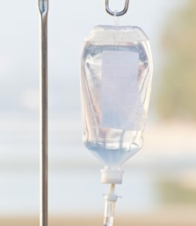




Introduction to advanced therapies

Slide 2

How to use this slide deck
This presentation has been developed to provide a general introduction to advanced therapies. It is aimed at healthcare professionals with limited prior knowledge of this topic.
The content in this training resource can be adapted as required to suit the needs of different audiences. Guidance is provided in the ‘notes’ section to support delivery of the slides.
Please acknowledge the Midlands-Wales Advanced Therapy Treatment Centre (MW-ATTC) for development of this material.
We would welcome your feedback and to hear about where these slides are used to deliver training: MWATTC@uhb.nhs.uk
Notes:
You may wish to remove this slide before delivering the training presentation to an audience.

Slide 3

Learning outcomes
By the end of this module you should:
  Understand some of the technical terms used to describe advanced therapy medicinal products (ATMPs)
  Be familiar with some examples of different types of advanced therapies
  Be aware of how these therapies are regulated in the UK
  Be able to describe some key challenges around delivery of advanced therapies

Slide 4




Directory of content
Background
Gene therapy
medicinal products
Somatic cell therapy medicinal products
Types of ATMP
with examples
Tissue engineered
products
Regulatory considerations
Combined ATMPs
Challenges
Supplementary material
including glossary and references
Notes:
This is to provide an outline of how the slide deck is structured.

Slide 5
What is an advanced therapy?
  Advanced therapies are a new class of biological medicines that are based on genes, cells, or tissues
  They offer ground-breaking new opportunities for the treatment of disease and injury
  Advanced Therapy Medicinal Products (ATMPs) are classified into 4 categories:
gene therapy
medicinal product
somatic cell therapy
medicinal product
tissue engineered
product
combined
ATMP
Notes:
Genes & cells are covered on the next two slides but some definitions are provided below:
Genes – the basic biological units of heredity. A gene is a section of DNA that provides a coded set of instructions, usually to make a protein.
Cells – the basic structural, functional, and biological units of all known living organisms. Cells contain the body’s hereditary material (genes) and can make copies of themselves.
Tissues – groups of cells that have a similar structure and act together to perform a specific function.

Slide 6
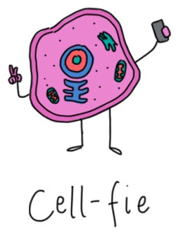
Revising the basics: cells and tissues
The human body contains an estimated 30 trillion human cells (plus another 39 trillion microbial cells).
A cell is the basic unit of life – the smallest unit capable of independent reproduction.
Tissues are groups of cells that have a similar structure and act together to perform a specific function.
Click to watch a video of a mesenchymal stem cell dividing
Notes:
First some quick revision of some basic concepts.
There are 4 thousand times more human cells in your body (~30 trillion) than there are people alive on the planet (~7.5 billion)!

Slide 7
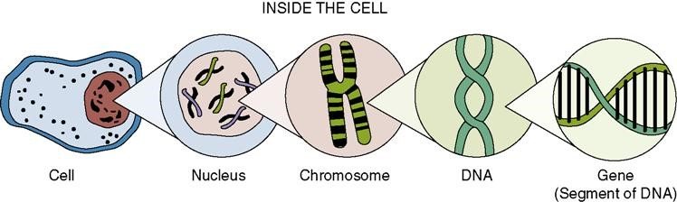
Revising the basics: genes
Inside the nucleus of each cell there are 23 pairs of chromosomes,
each made of tightly-coiled deoxyribonucleic acid (DNA).
Genes are short pieces of DNA that carry specific genetic information, sometimes instructing the cell how to make a protein.
Notes:
Inside a cell is the nucleus, this contains chromosomes, which are composed of DNA.
Like a ‘recipe’, genes contain the instructions to making proteins which are the building blocks for everything in the body.

Slide 8
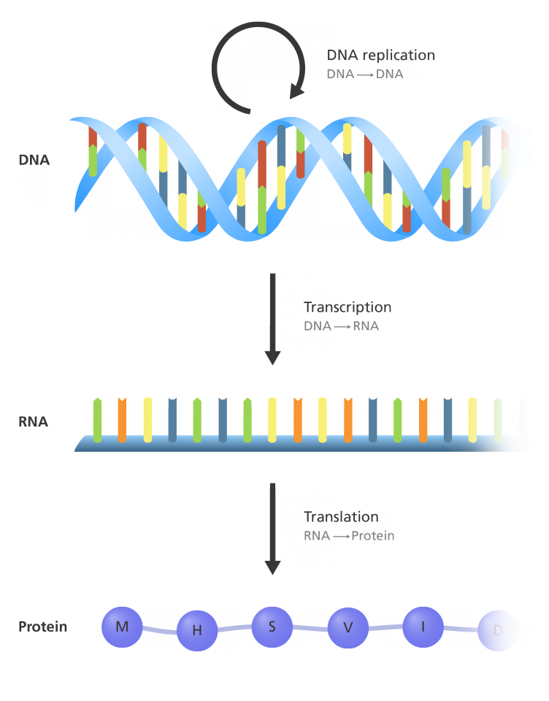
How does DNA instruct a cell to make proteins?
DNA contains the information needed to replicate itself
DNA also provides instructions that can be transcribed into an intermediate message called RNA
RNA is then translated into proteins that can perform all the functions necessary for life
Notes:
This is the central dogma of molecular biology – how ‘instructions’ are converted from DNA, first into RNA, then into proteins that are needed to support life.

Slide 9



Nucleic acids are biological molecules, typically DNA and RNA, that store
and transmit hereditary information in all living things.
Gene expression is the process by which the instructions in a gene are converted into a functional product, such as a protein.
Analogy:
DNA (deoxyribonucleic acid) = cookbook
Gene = recipe
Protein = chocolate cake
Gene expression = following the recipe to bake a chocolate cake
Recombinant nucleic acids can be produced by artificial manipulation in the lab
Analogy:
A sentence is cut out of a different cookbook and pasted into the chocolate cake recipe
The altered recipe now gives instructions to bake a birthday cake
Notes:
Some simple definitions and analogies may be useful depending on your audience

Slide 10

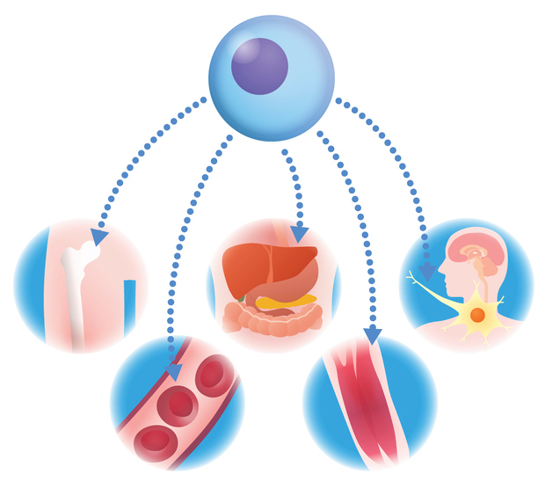
What is regenerative medicine?
Methods to replace or regenerate human cells, tissues or organs in order to restore or establish normal function.
This includes cell therapies, tissue engineering, gene therapy and biomedical engineering techniques, as well as more traditional treatments involving pharmaceuticals, biologics and devices.
This could encompass tissues and cells used for human application, such as hematopoietic stem cell transplants, as well as advanced therapy medicinal products (ATMPs).
As defined in 2013 House of Lords report on Regenerative Medicine
Notes:
You may hear the term ‘regenerative medicine’ used when talking about advanced therapy.

Slide 11
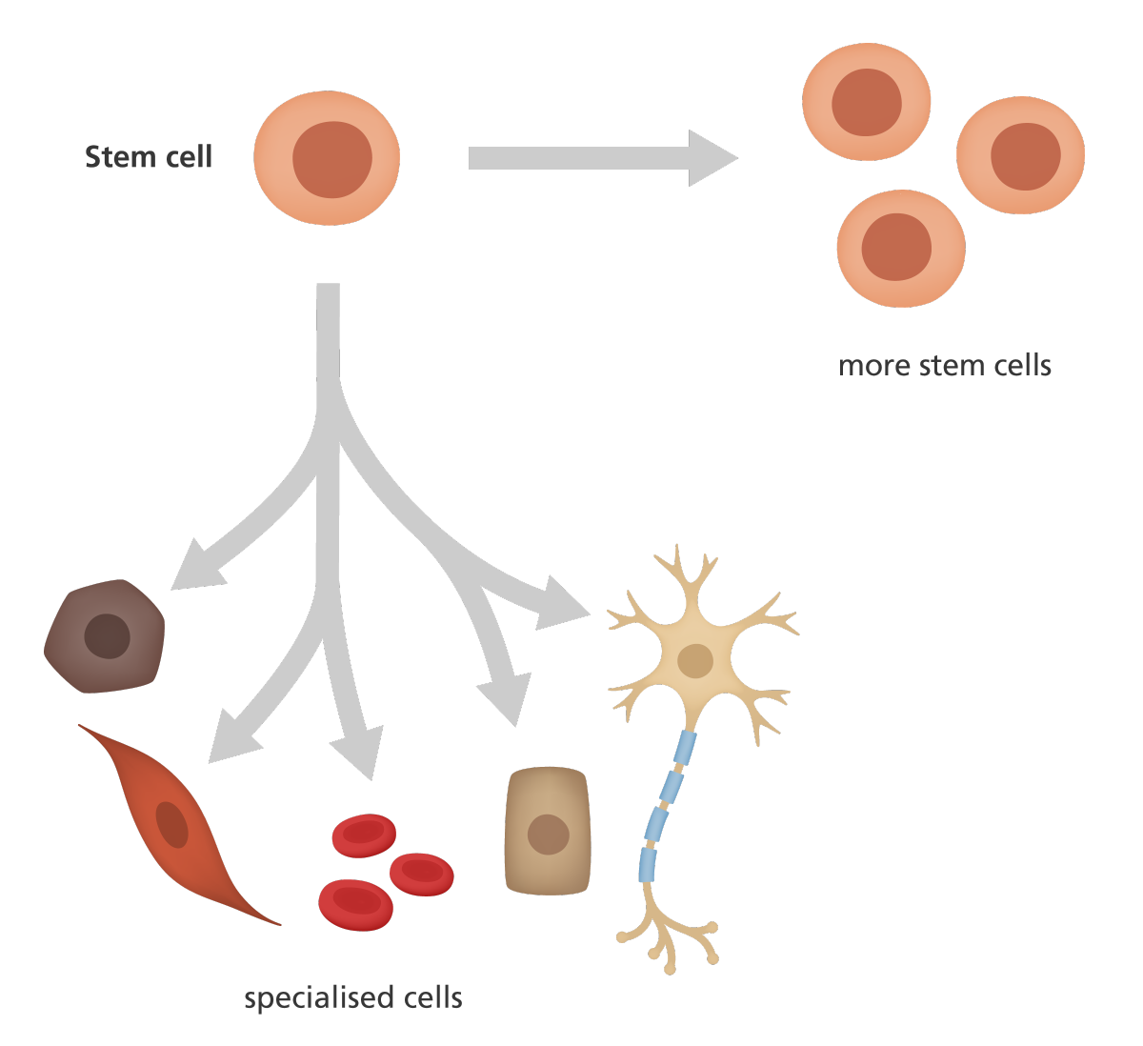
What is a stem cell?
Most cells are specialised to perform a particular function in the body
e.g. red blood cells transport oxygen
Stem cells are unspecialised cells
They can divide to produce new stem cells and they can differentiate (change) into the various types of cells in the body
Notes:
The next few slides introduce stem cells as these may be used to produce some types of advanced therapy.
Important: not all advanced therapies use stem cells (e.g. CAR T cell therapy uses T cells)
And not all treatments using stem cells are advanced therapies (e.g. a haematopoietic stem cell transplant of unmanipulated stem cells is not an advanced therapy)

Slide 12
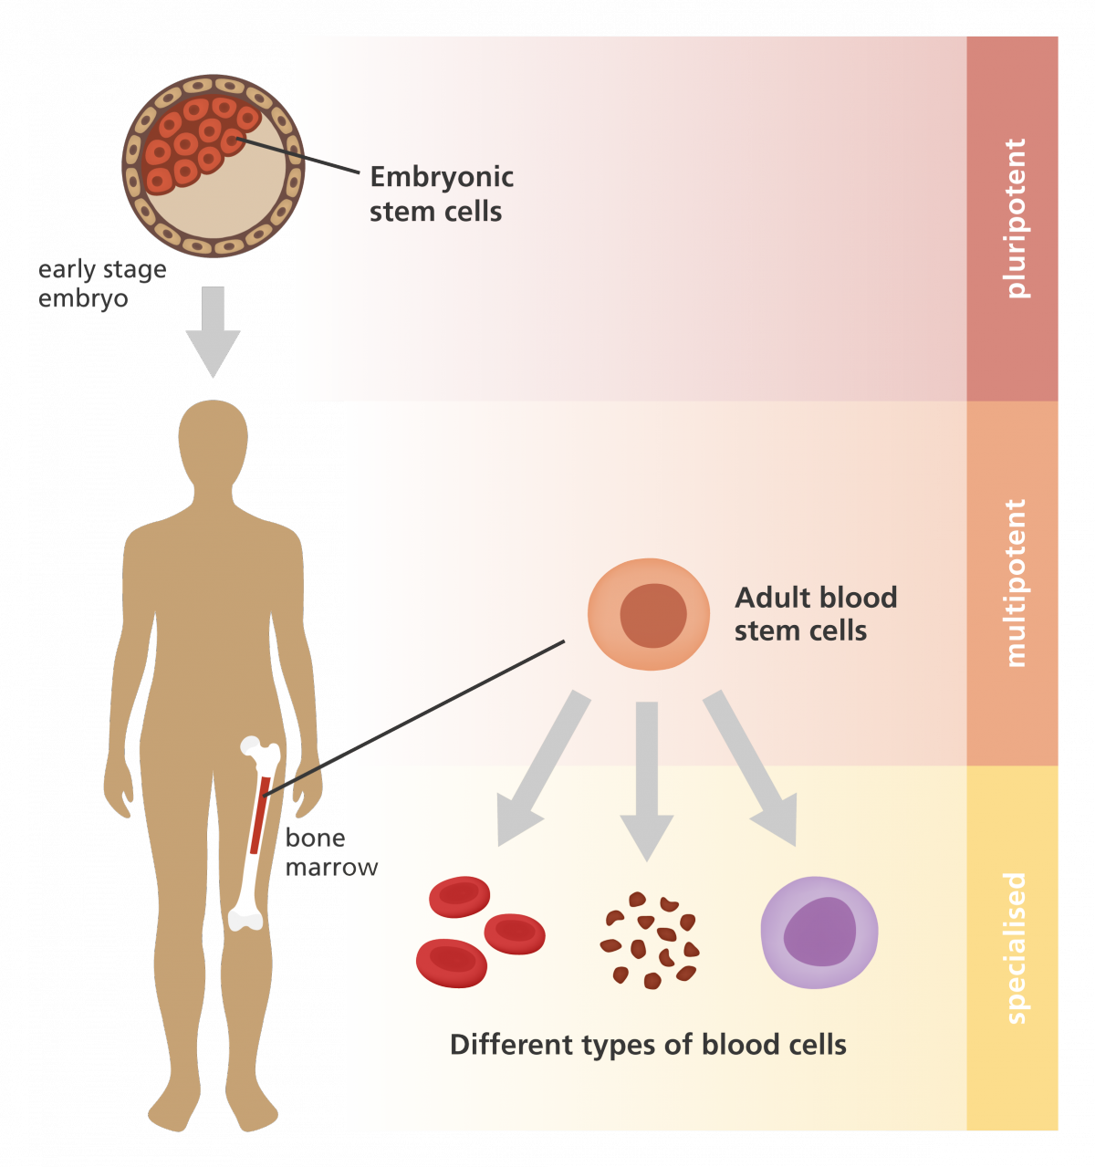
Types of stem cell
Embryonic stem cells are pluripotent
(give rise to all cell types of the body)
Adult stem cells are multipotent
(give rise to specialised cell types in a particular tissue or organ)
Haematopoietic stem cells are an example of an adult stem cell. They are found in the bone marrow and can develop into cells of the blood system.
Notes:
Confusingly, an adult stem cell is not only found in adults – they are also found in children. They are also called somatic stem cells.

Slide 13
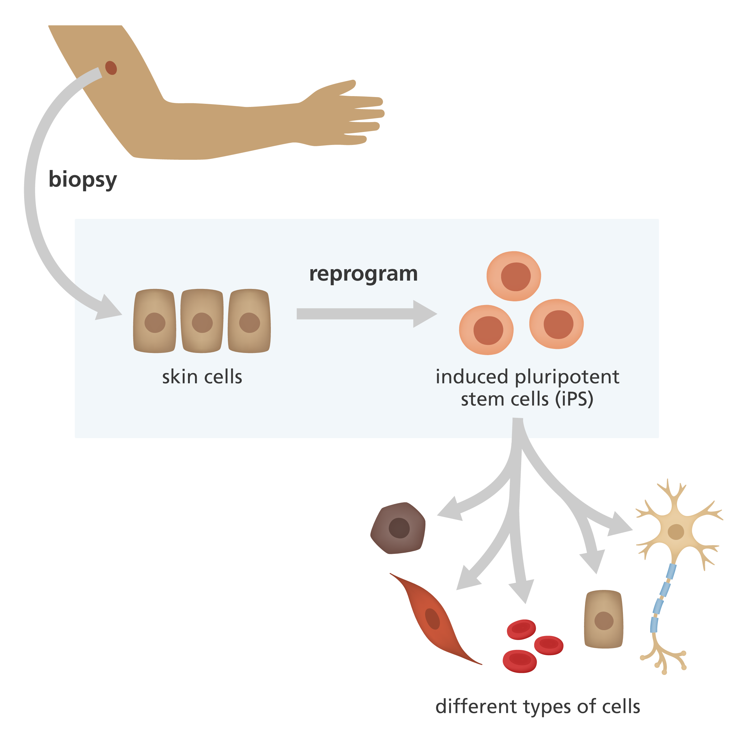
Types of stem cell
Induced pluripotent stem cells (iPSCs) are stem cells that have been produced by scientists.
Normal adult cells (like skin or blood cells) can be reprogrammed in the lab to become pluripotent. Scientists can switch off the genes that tell the cell to be specialised, and switch on genes that tell the cell to behave like a stem cell.
Early stage clinical trials are now investigating the therapeutic potential of cells derived from iPSCs.

Slide 14












A very brief history
1818
1953
1957
1990
1995
2006
2007
2012
2009
1965
2018
1980s
First recorded successful blood transfusion
First stem cell autograft (conjunctival limbal stem cells)
ADA-SCID gene therapy trials in Europe
ChondroCelect first ATMP authorised in Europe
Structure of DNA described
T cell receptor discovered
Induced pluripotent stem cells first produced
Glybera first gene therapy approved in Europe
First allogeneic bone marrow transplant
First gene therapy trial in USA
Term “ATMP” introduced in European directive
NICE approves two CAR T cell therapies

Slide 15
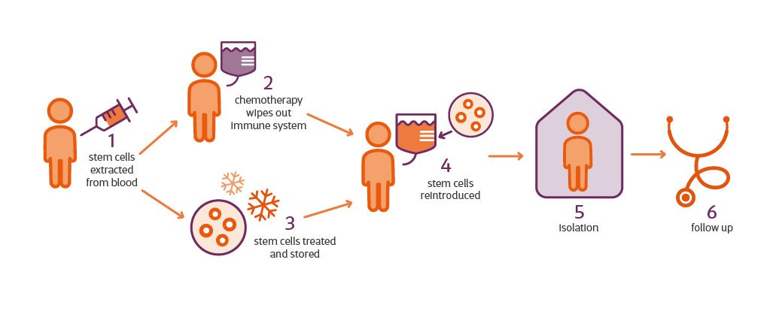
Not all cell therapy is an advanced therapy! e.g. haematopoietic stem cell transplant (HSCT):
cells returned for “homologous use”
(same essential function)
these cells are classed as a transplant, not a medicine
cells are not substantially manipulated
Notes:
There are some similarities between advanced therapies and more ‘traditional’ types of cell therapy, but it is important to understand the differences.
Haematopoietic stem cell transplant (HSCT) is used to treat certain cancers of the blood (like leukaemia, lymphoma and multiple myeloma) as well as a variety of non-malignant diseases including sickle cell disease, severe combined immune deficiencies and severe autoimmune diseases such as multiple sclerosis and scleroderma. Standard HSCT is NOT an advanced therapy.
In HSCT stem cells are usually extracted from the blood after being mobilised from the bone marrow using growth factors such as G-CSF.
They can also be harvested directly from the bone marrow or from umbilical cord blood. Depending on the clinical setting, the treatment may use the patient’s own stem cells or require cells from a donor.
Apart from minor manipulation in the lab (such as treating the cells for storage at ultra low temperature), the stem cells are not manipulated. There is no genetic modification, and they will be returned to the body for “homologous use” i.e. the same essential function (to generate blood cells).
The therapy is considered a transplant, not a drug.

Slide 16
How do advanced therapies differ from HSCT?
chemo is not required for all types of advanced therapy
may use cell types other than haematopoietic
stem cells
…cells are used for
“non-homologous use”
(a different function)
post-treatment care will look different depending on the therapy
some gene therapies do not use cells at all!
therapy classed as a medicine
and must be issued by Pharmacy
cells are substantially manipulated, or…
Notes:
In advanced therapies, cell types other than haematopoietic stem cells may be collected:
e.g. white blood cells to make CAR T cells
e.g. stem cells from the eye to repair a damaged cornea
NB in some gene therapies, cells are not taken out of the body at all.
The cells are either substantially modified in some way, or will be returned to the body for “non-homologous use” i.e. a different essential function.
The therapy is now classed as a medicine, so it must be issued by Pharmacy as with all other drugs.

Slide 17

Considerations around clinical delivery
Central role of pharmacy
Special care required in handling and storage
Often expensive to produce; may be unique and even irreplaceable
Close coordination needed across departments
Coordination with external companies, often internationally
Extended stay in/near to treatment hospital & follow up period
Management of patients’ expectations and concerns
Lack of staff awareness/experience of delivering these therapies
Notes:
Advanced therapies have different requirements to either standard stem cell transplantation or traditional pharmaceutical medicines
Care required in handling and storage - may have strict temperature requirements
Must be a clear chain of custody at all times – in hands of trained personnel only!

Slide 18

Pharmacy oversight
ATMPs are medicines
The Chief Pharmacist is responsible for ATMP governance
Hospitals must develop processes to ensure that:
Pharmacy have oversight of all ATIMP clinical trials and remain accountable for good clinical practice
Only staff with appropriate training and expertise handle these products
Appropriate technical and pharmaceutical advice is available locally
Robust governance procedures are in place
Notes:
For further info:
https://www.theattcnetwork.co.uk/wp-content/uploads/2019/06/The-Role-of-Pharmacy-in-the-Successful-Delivery-of-Advanced-Therapy-Medicinal-Products-ATMPs-1.pdf

Slide 19
Directory of content
Background
Gene therapy
medicinal products
Somatic cell therapy medicinal products
Types of ATMP
with examples
Tissue engineered
products
Regulatory considerations
Combined ATMPs
Challenges
Supplementary material
including glossary and references

Slide 20
Gene Therapy
Medicinal Product
Somatic Cell Therapy
Medicinal Product
Tissue Engineered
Product
Combined ATMP
GTMP
sCTMP
TEP
cATMP
Notes:
Now we will look at the different classes of ATMPs. We’ll focus on each classification in turn, including their formal definition.
First, Gene Therapy Medicinal Products (sometimes abbreviated to GTMPs)

Slide 21
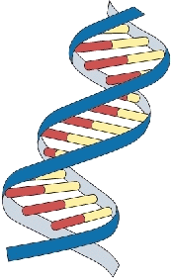
Gene therapy medicinal products
A gene therapy medicinal product (GTMP) is a biological medicine containing an active substance which:
contains or consists of recombinant nucleic acid(s).
It is administered to patients to regulate, repair, replace, add or delete a genetic sequence.
Its mechanism of action must be directly related to the recombinant nucleic acid sequence it contains, or to the product of genetic expression of this sequence.
GTMPs are defined in Directive 2001/83/EC, Annex I, Part IV

Slide 22
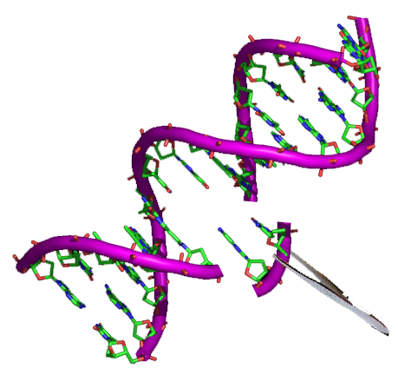
Genetically modified organisms (GMOs)
In most cases, gene therapy medicinal products will be classed as GMOs.
A genetically modified organism is defined as:
  an organism, with the exception of human beings, in which the genetic material has been altered in a way that does not occur naturally by mating and/or natural recombination.
GMOs are defined in Directive 2001/83/EC, Article 2

Slide 23
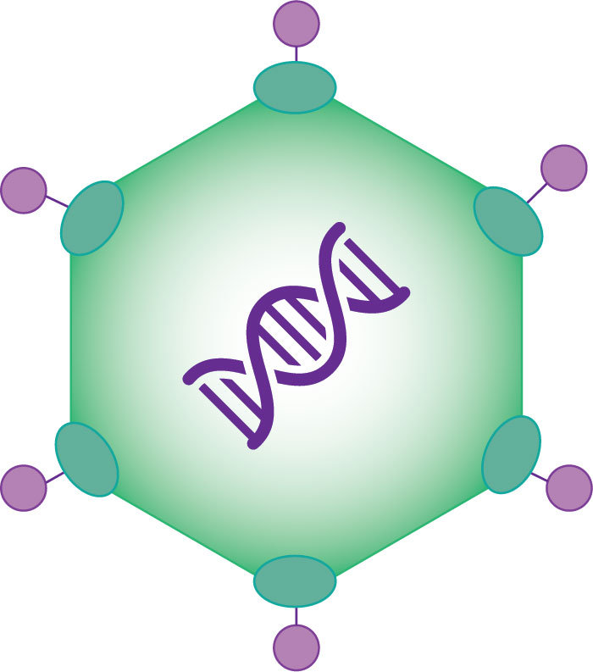






Delivering genetic material into cells
For gene therapies to work, the modified genetic material needs to be transported into target cells where the active gene product can be produced.
Vectors
are delivery vehicles or carriers
that encapsulate genetic material,
to protect & deliver it into target cells.
Viral vectors
Chemical or non-viral vectors e.g. lipoplex or polyplex
Direct injection of naked DNA into the body e.g. intramuscular injection
Physical methods e.g. gene gun or electroporation
Notes:
Viral vectors: modified viruses are used to carry DNA into target cells without causing viral disease.
e.g. adenoviruses, adeno-associated viruses, retroviruses and lentiviruses.
NB the virus is a harmless version – it cannot replicate or cause disease!
Chemical or ‘non-viral’ vectors such as:
lipoplexes – a complex of DNA + lipid
polyplexes – a complex of DNA + polymer
Physical methods such as:
Electroporation – pulses of high voltage carry DNA across the cell membrane
Gene gun – DNA is coated onto gold particles and forced into the cells
Sonoporation – ultrasonic frequencies are used to disrupt the cell membrane allowing DNA to move inside.
Direct injection: naked DNA can be injected directly into certain tissues, such as muscle or skin.

Slide 24
Gene therapy approaches
There are two main approaches to delivering gene therapy:
  In vivo
  The direct delivery of genes into cells that are still inside the patient’s body.
  This may be done via injection (e.g. intra-muscular, subcutaneous, intra-nodular, intravenous) or inhalation.
  Ex vivo
  Genes are modified in cells that have been taken out of the patient’s body.
  Once modified, the cells are then put back into the patient.
Notes:
The next slide shows a diagram to help explain this

Slide 25
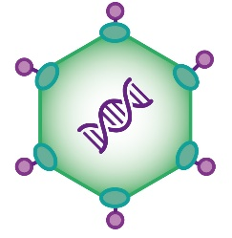






in vivo
Gene therapy approaches
ex vivo
Cells of interest are collected and grown in the lab
The therapeutic gene is delivered directly to the patient’s cells while they are still inside the body
The therapeutic gene is delivered into cells
outside of the body
The genetically modified cells are grown in large numbers outside of the body
The modified cells are administered to the patient
Notes:
in vivo: gene modification occurs inside the patient’s body
ex vivo: a therapeutic product is produced externally to the body

Slide 26
GTMP mechanisms of action: gene augmentation therapy
cell with a missing
or defective gene
addition of a
functioning gene
cell now functions
normally
Notes:
Gene augmentation therapy may be used to insert a functioning gene into cells where that gene is either missing or defective.

Slide 27
GTMP mechanisms of action: gene inhibition therapy
cell containing
a faulty gene
addition of a blocking gene
to inhibit the faulty gene
faulty gene is inhibited;
cell functions normally
Notes:
Gene inhibition therapy may be used to treat disease caused by inappropriate gene activity.
If a patient has a faulty gene that is causing disease, gene inhibition therapy may be used to introduce a blocking gene that can either:
inhibit the expression of the faulty gene itself
interfere with the activity of the product of the faulty gene’s expression.

Slide 28

GTMP mechanisms of action: suicide gene to kill disease cells
addition of a
suicide gene
suicide gene makes
a toxic product
diseased cell
diseased cell dies
Notes:
A suicide gene can be added to diseased cells. The toxic product made by the suicide gene then kills the disease cell.

Slide 29
GTMP mechanisms of action: redirecting the immune system
T cell is unable to recognise tumour cell
T cell is engineered to express a receptor specific for the tumour
modified T cell specifically targets & kills tumour cells
tumour cell
Tumour cell dies; modified T cell lives on
Notes:
T cells are white blood cells that help to protect the body from infection and destroy abnormal cells.
T cells can be engineered to express a receptor specific for something on the surface of tumour cells.
The modified T cells are then able to target and kill tumour cells.
After killing a tumour cell, a modified T cell can live on to fight further tumour cells.
This is how CAR T cell therapy works. More on this later.

Slide 30
GTMP mechanisms of action: marking diseased cells for destruction
addition of a
marker gene
marker proteins
expressed on cell
immune system
attacks marked cell
diseased
cell dies
diseased cell
Notes:
A marker gene can be added to diseased cells. The disease cell is then decorated with markers that instruct the immune system to attack it.

Slide 31
Gene Therapy
Medicinal Product
Somatic Cell Therapy
Medicinal Product
Tissue Engineered
Product
Combined ATMP
GTMP
sCTMP
TEP
cATMP
Notes:
Next – somatic cell therapy medicinal products

Slide 32
Somatic cell therapy medicinal products
A sCTMP is a biological medicine which contains or consists of cells or tissues that:
have been subject to substantial manipulation to change their biological characteristics, physiological functions or structural properties,
and/or
that are not intended to be used for the same essential function(s) in the body.
Used to treat, prevent or diagnose a disease through the pharmacological, immunological or metabolic action of its cells or tissues.
Somatic
Any cell of a living organism other than the reproductive (sperm and egg) cells
sCTMPs are defined in Directive 2001/83/EC, Annex I, Part IV
https://ec.europa.eu/health/sites/health/files/files/eudralex/vol-1/dir_2001_83_consol_2012/dir_2001_83_cons_2012_en.pdf
Notes:
“Substantial manipulation” will be explained on the next slide

Slide 33










Examples of substantial manipulation
Not considered to be substantial manipulation
Defined in Regulation (EC) 1394/2007, Annex 1
Cell expansion
(cell culture)
Enzymatic digestion of tissue
Cutting
Grinding
Shaping
Soaking in antibiotics/ antimicrobials
Sterilization Irradiation
Centrifugation
Genetic
modification
of cells
Differentiation or activation with growth factors
Cell separation
Cell concentration
Cell purification
Freezing cryopreservation Vitrification
Filtering
Lyophilization

Slide 34
Example of “substantial manipulation” during production of TILs
tumour excised
tumour infiltrating lymphocytes (TILs) isolated
cell expansion (cell culture) to grow more lymphocytes
= substantial manipulation

Slide 35
Gene Therapy
Medicinal Product
Somatic Cell Therapy
Medicinal Product
Tissue Engineered
Product
Combined ATMP
GTMP
sCTMP
TEP
cATMP
Notes:
Next – tissue engineered products

Slide 36
Tissue engineered products
A TEP is a biological medicine which contains engineered cells or tissues that
are used to regenerate, repair or replace human tissue.
“Engineered” cells or tissues:
have been subjected to substantial manipulation
and/or
are not intended for the same essential function(s) in the body
It may contain cells or tissues of human or animal origin (or both) and they may be viable or non-viable.
It may also contain additional substances, such as cellular products, bio-molecules, biomaterials, chemical substances, scaffolds or matrices.
TEPs are defined in Article 2 1(b) of Regulation (EC) 1394/2007
https://ec.europa.eu/health//sites/health/files/files/eudralex/vol-1/reg_2007_1394/reg_2007_1394_en.pdf
Notes:
Note that tissue engineered products are used to regenerate, repair or replace human tissue.
Whereas somatic cell therapy medicinal products treat, prevent or diagnose a disease through the pharmacological, immunological or metabolic action of its cells or tissues.
Definitions:
A viable cell has a functional cytoplasmic membrane and is capable of producing energy and synthesising new molecules from raw materials.
Non-viable cells do not display these properties.

Slide 37
Gene Therapy
Medicinal Product
Somatic Cell Therapy
Medicinal Product
Tissue Engineered
Product
Combined ATMP
GTMP
sCTMP
TEP
cATMP
Notes:
Finally – combined ATMPs

Slide 38
Combined Advanced Therapy Medicinal Products (cATMPs)
A combined ATMP must incorporate, as an integral part of the product,
one or more medical devices or implantable medical devices,
as well as a cellular or tissue component.
For example – cells embedded in a biodegradable matrix or scaffold.
The cellular or tissue component must:
contain viable cells or tissues
or
Its non-viable cells or tissues must be liable to act upon the human body with action that can be considered as primary to that of the medical device(s).
cATMPs are defined in Article 2 1(b) of Regulation (EC) 1394/2007
https://ec.europa.eu/health//sites/health/files/files/eudralex/vol-1/reg_2007_1394/reg_2007_1394_en.pdf
Notes:
A combined ATMP is one that has been combined with one or more medical devices.
A medical device is defined as any instrument, apparatus, appliance, material, or other article intended by the manufacturer to be used on human beings for the purpose of: i) diagnosis, prevention, monitoring, treatment or alleviation of disease, compensation for an injury or handicap, investigation, replacement, or modification of the anatomy of a physiological process, or control of conception and ii) which does not achieve its principal intended action in or on the human body by pharmacological, immunological, or metabolic means, but may assist its function by such means (European Union, 2017).
Examples of medical devices in cATMP could be a scaffold, matrix, or encapsulation systems for cells such as microspheres.

Slide 39




Summary of ATMP classifications
Classification | Contains or consists of | Used to | Defined
Gene therapy medicinal product | recombinant nucleic acid(s) | regulate, repair, replace, add or delete a genetic sequence | Directive 2001/83/EC, Annex I, Part IV
Somatic cell therapy medicinal product | cells or tissues substantially manipulated or used for a different function | treat/prevent/diagnose disease by pharmacological/ immunological/ metabolic action
Tissue engineered product | cells or tissues substantially manipulated or used for a different function | regenerate, repair or replace human tissue | Regulation (EC) 1394/2007, Article 2 1(b)
Combined ATMP | cells or tissues + medical device(s) | as above

Slide 40
A therapeutic product that may fall within the definitions of:
a somatic cell therapy (sCTMP)
AND a tissue engineered product (TEP)
shall be considered a tissue engineered product.
sCTMP
TEP
TEP

Slide 41
A therapeutic product that may fall within the definitions of:
a somatic cell therapy (sCTMP) OR a tissue engineered product (TEP)
AND a gene therapy medicinal product (GTMP)
shall be considered a gene therapy medicinal product.
sCTMP
GTMP
GTMP
GTMP
TEP
Notes:
A good example of this is CAR T cell therapy – technically this is a gene therapy medicinal product, although it also fulfils the definition of a somatic cell therapy medicinal product.

Slide 42
Terminology check
Regulatory classification
Starting material
Manufacturing model
Shipping temperature
Autologous
Centralised
Fresh
Gene therapy
Somatic cell therapy
Tissue engineered product
or
Combined ATMP
or
Frozen (cryopreserved)
or
Localised
(point of care)
or
Allogeneic
(ambient)
Notes:
We’ve just covered the four different regulatory classifications (blue box)
It’s important to be familiar with these additional terms – they will be explained in the following slides

Slide 43
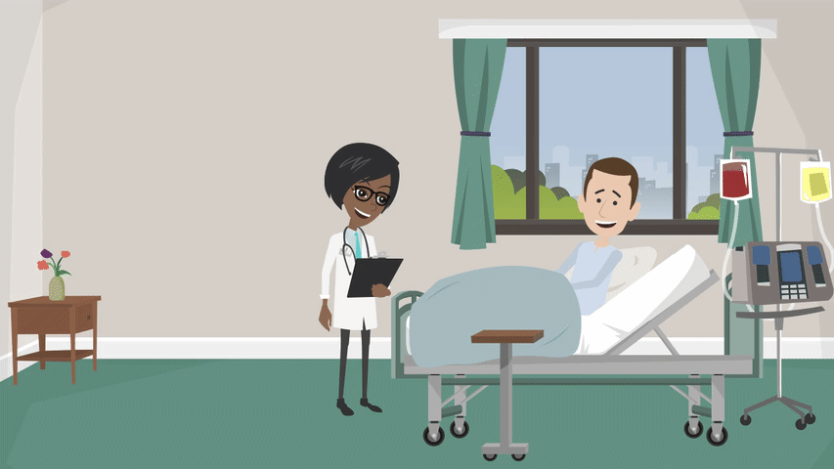

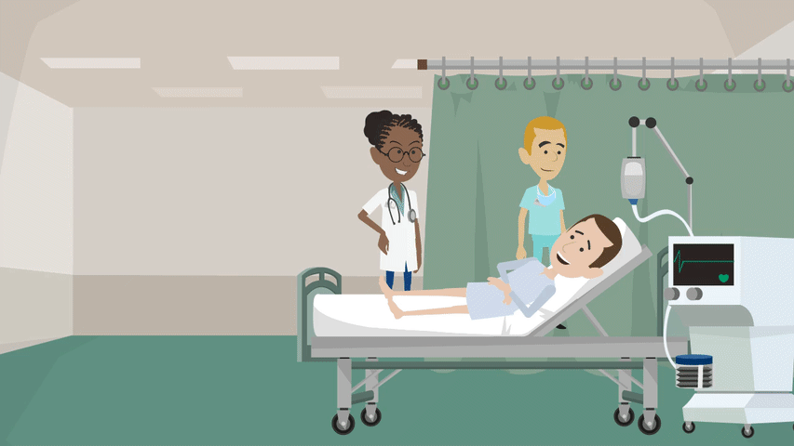


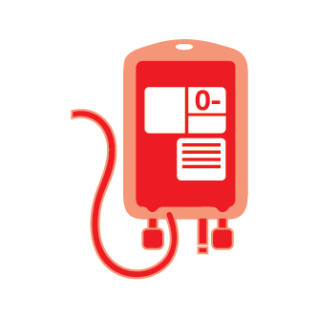
Autologous therapy
collection from the patient
manufacture
administration to patient
The patient’s own cells are used as starting material to make the therapy
Notes:
For AUTOLOGOUS therapy the starting material is collected from the patient themselves. E.g.:
Haematopoietic progenitor (stem) cells by bone marrow aspiration or apheresis after GM-CSF mobilisation
White blood cells collected by leukapheresis
Tumour resection or biopsy
Manufacture – the starting material is turned into the therapeutic product
Routes of administration can include:
IV infusion
Intradermal/intramuscular injection
Surgical procedure
May be one-off or repeated.

Slide 44
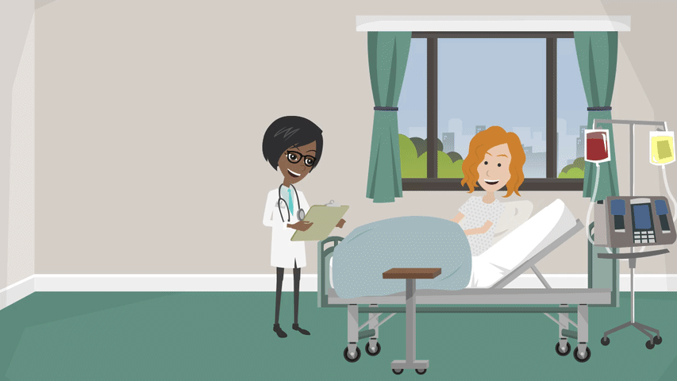
Allogeneic therapy
collection from a donor
manufacture
administration to patient
Someone else donates starting material (cells) to make the patient’s therapy
Notes:
For ALLOGENEIC therapy the starting material is collected from a donor, someone other than the patient.
e.g.:
Donor stem cell collection
Donor leukapheresis
Umbilical cord blood
Donor registries may facilitate provision of starting material (e.g. Antony Nolan, NHS Cord Blood Bank)

Slide 45



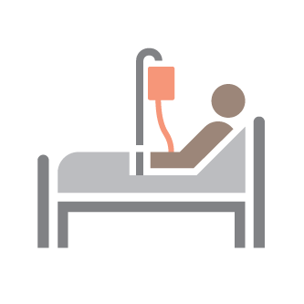


Centralised manufacturing model
central manufacturing facility
cell collection (starting material)
pharmacy receipt, checks and issue
therapy
administered
production and testing of final therapeutic product
potential for storage step
Notes:
Advanced therapies are often manufactured at a centralised facility – which may be in another country. It is critical that the starting material and the final product are transported safely and securely according to carefully tested procedures.
Some therapies may be delivered fresh (perhaps at ambient temperature, or on cool packs), while other therapeutic products are cryopreserved (frozen).
Cryopreserved products may sometimes be stored at a third party storage centre prior to being delivered to the clinical site.

Slide 46

Localised/point of care manufacturing model
local manufacturing facility at/near the hospital
Local production
and testing of
final therapeutic
product
cell collection (starting material)
pharmacy receipt, checks and issue
therapy
administered
Notes:
A localised manufacturing model involves the therapy being produced and tested at/close to the hospital, usually reducing the need for long-distance transportation – the product may be walked across from the manufacturing facility to the clinic/ward.
Still, the final product may be fresh or frozen – it’s different for each therapy.

Slide 47
Example advanced therapies (click to learn more)
CAR T: B cell malignancies
Alofisel: Crohn’s
Holoclar: corneal repair
MACI: cartilage repair
Strimvelis: ADA-SCID
Provenge: prostate cancer
ACI: cartilage repair
Gene therapy: sickle cell
TILs: melanoma
Gene therapy: EBA
Click here to skip examples and move on to regulation
Glybera: LPL deficiency
Notes:
Choose a selection of example therapies to talk about depending on what is relevant or of interest to your audience, and how long you have!
Things to note:
For gene therapies the mode of action is directly related to a recombinant nucleic acid sequence or its product.
For somatic cell therapies (yellow) the objective is to treat, prevent or diagnose a disease through the pharmacological, immunological or metabolic action of the cells or tissues.
For tissue engineered products (green) the mode of action is to regenerate, repair or replace human tissue.
There is only one example of a combined ATMP (orange) – so far the only one approved in Europe.
When you are finished looking at example therapies and ready to move on to regulation, click ‘skip examples and go to regulation’

Slide 48

CAR T cells: creating cancer assassins
T cells are white blood cells that help to protect the body from infection and destroy abnormal cells.
T cells can be genetically engineered in the lab to express an artificial chimeric antigen receptor (CAR) that directs them to target cells expressing a specific marker (or antigen).
CAR T cell therapies have proven very effective targeting certain types of blood cancer, even in patients for whom standard treatment has not been effective.
Emily Whitehead, first child in the world to be treated with CAR T cell therapy in 2012.
Notes:
One exciting new type of immunotherapy is CAR T cell therapy.
Immunotherapy: the prevention or treatment of disease with substances that stimulate a immune response
T cells are white blood cells that help to protect the body from infection and destroy abnormal cells.
They can be genetically engineered in the lab to express an artificial receptor on their surface called a chimeric antigen receptor (CAR).
The CAR reprograms the cell to recognise a specific marker (or ‘antigen’) on the surface of cancer cells. When the reprogrammed CAR T cells are put back into the patient’s bloodstream, they can find and destroy the cancer cells.
CAR T therapy is usually a single-dose treatment and is hoped to offer long-term protection against the cancer.

Slide 49
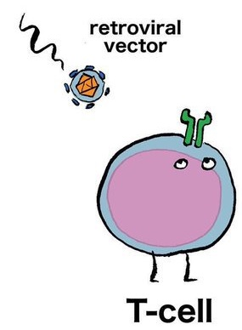
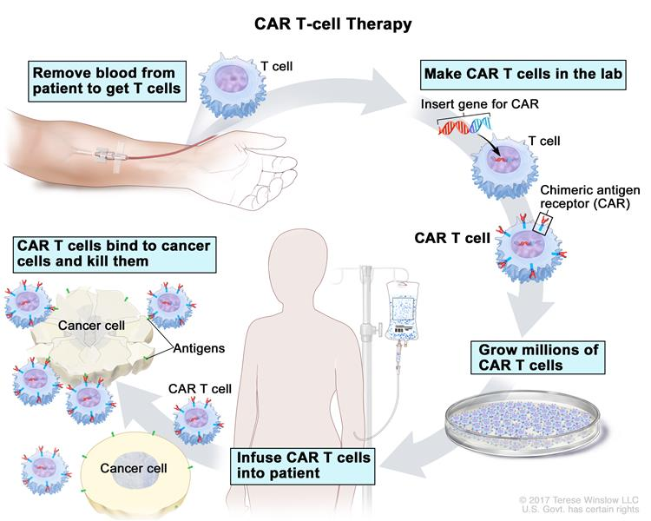


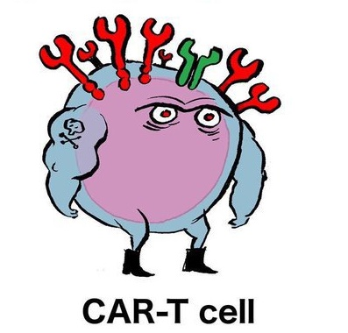
CAR T cells: creating cancer assassins
cancer.gov/publications/dictionaries/cancer-terms/def/car-t-cell-therapy
facebook.com/pedromics
Notes:
White blood cells are collected from the patient’s blood by a process called leukapheresis.
The cells are then usually cryopreserved in a specialist laboratory (such as a stem cell lab).
The frozen white blood cells are then transported to a manufacturing facility. A chimeric antigen receptor (CAR) is delivered into the T cells using a viral vector.
The CAR re-programmes the T cells to recognise a marker (or antigen) on the cancer cells.
The patient is given chemotherapy to prepare for the CAR T cell infusion.
The “CAR T cells” are thawed at the bedside and infused into the patient’s bloodstream. The CAR T cells then specifically seek and destroy the cancer cells. The CAR T cells proliferate inside the patient and live on to attack additional cancer cells expressing the marker they have been trained to recognise.
CAR T cell therapy is an example of an ex vivo gene therapy - production of the therapeutic product occurs outside the body.

Slide 50





CAR T cells side effects and toxicities
Cytokine release syndrome (CRS)
Tumour lysis
syndrome
On-target, off-tumour toxicity
Neurotoxicity
Allergic reactions and anaphylaxis
Notes:
This cutting edge treatment often leads to serious side effects, so is currently only available in specialist centres where patients can be closely monitored.
Cytokine release syndrome (CRS) - Depending on the patient and the CAR T cells, CRS may occur within 1 to 21 days of CAR T cell infusion. The duration of CRS is variable and it depends on the type of intervention used to manage it. The severity of CRS can be on a spectrum too. On the mild end, a patient might just feel like they have the flu. Because of the potential for fatal outcomes, severe or life‐threatening CRS is a medical emergency and requires intensive care treatment. Interleukin-6 (IL-6) seems to be a primary mediator of CRS. Tocilizumab is a monoclonal antibody (mAb) used to treat CRS. It works by blocking IL-6 signalling.
Cytokines (chemical messengers that help the T cells carry out their functions) are produced when the CAR T cells multiple in the body and kill the cancer cells.
CRS symptoms can range from mild flu-like symptoms that include:
Nausea, Fatigue, Headache, Chills, Fever
The symptoms of CRS can also be more serious such as:
Low blood pressure
Tachycardia (abnormally rapid heart rate)
Capillary leakage (fluid and proteins leaking out of tiny blood vessels and flowing into surrounding tissues, resulting in dangerously low blood pressure)
Cardiac arrhythmias/arrest
Hemophagocytic lymphohistiocytosis (life-threatening immune system activation)/macrophageactivation syndrome (life-threatening activation of macrophages) (HLH/MAS)
Hypoxia (lack of oxygen reaching the tissue)
Renal insufficiency (poor function of the kidneys)
Poor lung oxygenation
Multiple organ failure
Neurological symptoms
Neurotoxicity – mechanism poorly understood. Common symptoms include language impairment (aphasia), confusion, delirium, involuntary muscle twitching, hallucinations, or unresponsiveness. Seizures have also been reported.
Neurotoxicity has been reversible in most cases and the symptoms have resolved over several days without intervention or apparent long-term effects, however there can be life-threatening adverse neurological events.
Tumor lysis syndrome - metabolic complications that can occur due to sudden and/or massive killing of tumour cells
On-target, Off-tumor Toxicity - damage to such noncancerous normal tissue by CAR T cells. Therapies targeting CD19 also kill the patient’s healthy B cells, as well as cancerous ones, resulting in B cell aplasia.
Allergic reactions and anaphylaxis – may be due to DMSO, dextran 40 or residual gentamicin

Slide 51
CAR T cells: creating cancer assassins
“CAR-T therapy is a true game changer
and NHS cancer patients are now going to be amongst the first in the world to benefit.”
Simon Stevens, Chief Executive of NHS England
“CAR T-cell therapy is the most promising breakthrough in blood cancer treatment of the past decade, with the potential to be used much more widely in the future.”
Dr Alasdair Rankin, Director of Research and Patient Experience at the blood cancer charity Bloodwise
Back to example ATMPs
Notes:
The chief executive of NHS England Simon Stevens has very recently spoken about the importance of the NHS embracing CAR-T therapy and has announced that preparations are underway to make CAR T cells therapies available within the NHS later this year. He also appealed to manufacturers for their help in delivering these treatments to patients as quickly and cost-effectively as possible.

Slide 52
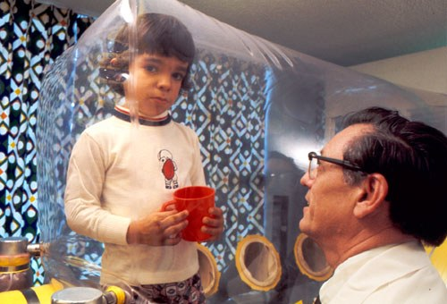
Strimvelis: bursting the bubble
ADA–SCID is a rare inherited condition that affects ~15 patients per year in Europe.
Patients have a genetic deficiency in an enzyme that is essential for maintaining healthy lymphocytes. Their immune systems are severely impaired which can result in life-threatening infections.
Treatment for ADA–SCID includes allogeneic haematopoietic stem cell transplant. These are carry risks and it is not always possible to find a good match.
In February 2018 NICE approved Strimvelis for treating ADA-SCID patients without a suitably matched stem cell donor.
Children with ADA-SCID are extremely vulnerable to infection and usually live in isolation to minimise the risk, hence the nickname ‘bubble baby syndrome’
Notes:
Adenosine deaminase deficiency–severe combined immunodeficiency (ADA–SCID)
Lymphocytes – white blood cells that fight off infections
Allogeneic HSCT – a procedure in which a patient receives a transplant of blood-forming stem cells from a genetically similar donor.
Strimvelis improves overall survival compared with HSCT.
Intervention-free survival after Strimvelis was 15/17 patients in clinical trials. Difficult to compare with HSCT.
Expected to increase in clinical practice because of:
the restriction of the use of Strimvelis to only people who are expected to produce enough CD34+ cells
the expertise gained in administering Strimvelis during the 15‑year timeframe of the trials.

Slide 53




Strimvelis: bursting the bubble
Clinical site
Clinical site
Manufacturing lab
1
Bone marrow-derived blood-forming stem cells are collected from the patient
2
A healthy copy of the ADA gene is inserted into the patients’ stem cells using a viral vector
4
The patient undergoes chemotherapy to wipe out their remaining faulty stem cells
The new, modified stem cells are infused into the patient’s bloodstream and transported to the bone marrow where they engraft and repopulate the patient’s blood with new healthy cells that produce ADA
3
The modified stem cells are expanded in the laboratory
Notes:
ADA = adenosine deaminase
The patient will now be able to build a functioning immune system that will improve their ability to fight infection.
Strimvelis is an autologous, ex vivo gene therapy

Slide 54
Strimvelis: bursting the bubble
“Children born with ADA-SCID will now have a better chance of being able to lead as near normal a life as possible, going to school, mixing with friends, free from the constant threat of getting a potentially life-threatening infection.”
Professor Carole Longson, Director of the
Centre for Health Technology Assessment, NICE
Back to example ATMPs

Slide 55
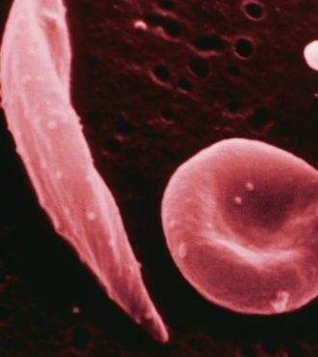
Transforming lives for sickle cell patients
Sickle cell disease is a lifelong condition caused by a faulty gene that affects how red blood cells develop.
Patients experience problems with flow of blood around the body. This can cause intense pain, anaemia, bacterial infections, organ damage and may be fatal. Patients often need lifelong blood transfusions every few weeks.
In 2017 a 13 year old boy with sickle cell disease received an experimental gene therapy. Stem cells were collected from his bone marrow and modified in the lab by introducing healthy copies of the haemoglobin gene.
Over two years after treatment, he has enough normal red blood cells to avoid transfusions, and no longer suffers any of the effects of the disorder.
Healthy red blood cells are round, but a genetic defect in sickle cell patients deforms the cell shape.
Notes:
In the UK alone 14,000 people have this condition.
In March 2017, French researchers announced a world first – a 13 year old boy had been cured of sickle-cell disease after receiving an experimental gene therapy. Blood forming stem cells were collected from the boy’s bone marrow and modified in the lab by introducing healthy copies of the haemoglobin gene.
When the treated cells were infused back into his body, they began to make normal blood cells. More than two years after treatment, the patient has enough normal red blood cells to avoid transfusions, and no longer suffers any of the effects of the disorder.

Slide 56
Transforming lives for sickle cell patients
Clinical site
Clinical site
Manufacturing lab
1
Bone marrow-derived blood-forming stem cells are collected from the patient
2
A healthy copy of the beta globin gene is inserted into the patients’ stem cells using a viral vector
4
The patient undergoes chemotherapy to wipe out their remaining faulty stem cells
The new, modified stem cells are infused into the patient’s bloodstream and transported to the bone marrow where they engraft and repopulate the patient’s blood with new healthy red blood cells
3
The modified stem cells are expanded in the laboratory
Notes:
β-globin = the gene that is mutated in patients with sickle cell disease
This is an example of an autologous, ex vivo gene therapy

Slide 57
Transforming lives for sickle cell patients
“All the tests we performed on his blood show that he’s been cured of sickle cell disease”
Dr Marina Cavazzana,
Hôpital Universitaire Necker, Paris
Until now, the only way to treat someone was with a matched sibling transplant. But many patients do not have a full sibling, and even if they do, there is only a 15% chance of a match.
“This is a huge deal…. we hope it will be curative, but we can’t say that yet”
Dr Julie Kanter,
University of Alabama
Back to example ATMPs

Slide 58
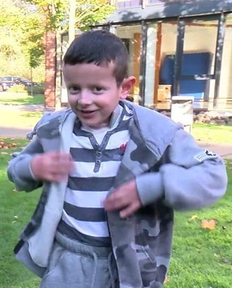
Growing life-saving new skin
Junctional epidermolysis bullosa is a rare, inherited connective tissue disorder that causes the skin to become extremely fragile.
Trauma or friction to skin results in blisters and tears, requiring painful daily wound dressing and risking frequent infections.
In 2017 an experimental gene therapy approach was used to treat a 7-year-old boy with EB living in Germany. He had lost 80% of his epidermis and developed severe infections and sepsis. Transplanting healthy skin from his father had failed to help.
Notes:
In November 2017, researchers in Germany reported the ground breaking use of gene therapy to treat a young boy with the devastating connective tissue disorder junctional epidermolysis bullosa. Patients with junctional epidermolysis bullosa have a genetic defect in the anchoring proteins that attach the epidermis to the dermis of the skin. Skin is extremely fragile, blisters and tears, requires painful daily wound dressing and is prone to infections and skin cancer.
When a bacterial infection threatened the life of this patient, the medical team decided to use an experimental approach of grafting genetically modified stem cells on to wound surfaces.

Slide 59
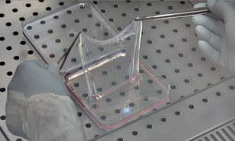
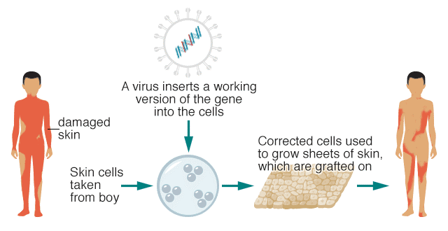
Growing life-saving new skin
Scientists in Italy grew cells from an unblistered patch of the boy’s skin.
A healthy version of the faulty gene was added using a viral vector before growing cells into sheets.
9 square feet of laboratory-grown, genetically-corrected skin was grafted over 3 surgeries.
Two years after treatment, the patient continues to enjoy a vastly improved quality of life.
Notes:
Scientists grew cells from an unblistered patch of his skin. They isolated skin stem cells and added a healthy version of the faulty gene using a viral vector. They let the modified cells grow into small sheets in the lab
The sheets were transplanted onto the patient’s body. Over a series of 3 surgeries, 9 square feet of laboratory-grown, genetically-corrected skin was grafted.
Two years after the treatment, the young boy continues to enjoy a vastly improved quality of life.
This is an example of autologous, ex vivo gene therapy.

Slide 60
Growing life-saving new skin
“I have never experienced anything else that worked out so well”
Dr Tobias Rothoeft,
Ruhr-Universität Bochum
“Today this treatment is not available and it is not going to be available in the next few months, but this is a massive advance in research and is going to give us hope going forward with gene therapy”
Dr Anna Martinez,
Great Ormond Street Hospital
Back to example ATMPs
Link to BBC video: https://www.bbc.co.uk/news/health-41914101

Slide 61
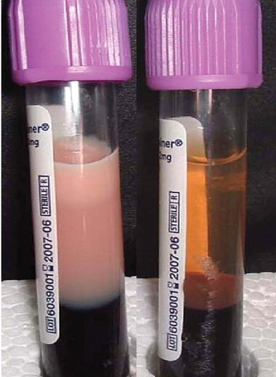
Glybera: the million dollar drug
Patients with familial lipoprotein lipase deficiency (LPLD) lack an essential protein that processes dietary fat.
Their blood becomes thick and white with fat particles – can lead to organ damage.
Glybera was the world’s first gene therapy to receive EU marketing authorisation (2012). With a treatment cost of $1m per patient, Glybera became the most expensive drug in the world.
Glybera was withdrawn from the market in 2017 due to a lack of demand.
The blood of people with LPLD can have a milky appearance due to a high fat content.
Notes:
Familial lipoprotein lipase deficiency (LPLD) is an ultra-rare genetic disorder that affects 1-2 per million people.
LPLD patients must follow a very strict diet and experience periods of debilitating abdominal pain that can be life-threatening.

Slide 62

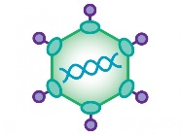
Glybera: the million dollar drug
1
A viral vector is used to deliver a functioning LPL gene directly to the patient’s muscle cells via
intra-muscular injections.
2
The muscle cells start to produce lipoprotein lipase, allowing the patient to process fat normally.
Notes:
LPL = lipoprotein lipase
Glybera is an example of an in vivo gene therapy

Slide 63
Glybera: the million dollar drug
Glybera was sold only once, paid for by a private insurance company.
A few remaining doses were given away for €1 each.
Then the drug was pulled from the market.
“Glybera’s usage has been extremely limited and we do not envision patient demand increasing materially in the years ahead.”
Matt Kapusta,
CEO of Glybera manufacturer uniQure
“Glybera was too expensive, no doubt”
Dr Daniel Gaudet,
Université de Montréal,
Back to example ATMPs

Slide 64
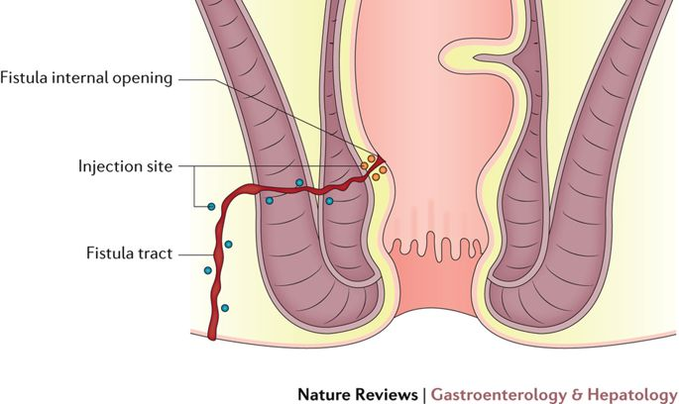
Alofisel: Combating Crohn’s
Perianal fistulas are a common complication of Crohn’s disease, affecting more than 20% of patients (Crohn’s & Colitis UK).
Following promising clinical trial results, Alofisel (darvadstrocel) became the first allogeneic ATMP to gain European marketing authorisation in March 2018.
However, NICE concluded that it could not recommend Alofisel to be made available in the NHS due to uncertainty over efficacy.
Panés and Rimola 2017
Notes:
Crohn’s disease – a chronic, inflammatory disease of the digestive system. It is one type of a condition called inflammatory bowel disease (IBD).
Perianal fistulas occur when an abnormal passageway develops between the rectum and the outside of the body, causing pain and potentially leading to incontinence and sepsis. More than 20% of Crohn’s patients experience perianal fistula (source: Crohn’s and Colitis UK).
Image: Injection of mesenchymal stem cells in perianal fistulas. After closing the internal opening of the fistula using absorbable stitches, a suspension of mesenchymal stem cells is injected, with half of the dose distributed into the tissue adjacent to all fistula tracts (blue spots) and the other half around the internal openings (yellow spots).
NICE: National Institute for Health and Care Excellence

Slide 65
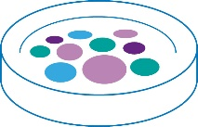
Alofisel: Combating Crohn’s
Clinical site
Manufacturing lab
1
Liposuction used to collect adipose (fat) tissue from a donor
2
Donor adipose-derived mesenchymal stem cells selected and expanded in the laboratory
3
Cells injected into the fistula under anaesthetic
The injected cells help to reduce inflammation and support the growth of tissue that encourages the fistula to heal

Slide 66
Alofisel: Combating Crohn’s
“Alofisel offers a novel, minimally invasive and well tolerated alternative treatment option for patients with Crohn’s disease who do not respond to currently available therapies, and who have until now had limited treatment options available.”
Professor Julian Panés,
Head of Gastroenterology at Hospital Clinic of Barcelona,
President of the European Crohn's and Colitis Organisation
“…only an additional 14% of people showed a beneficial effect from darvadstrocel over and above placebo. Reliable follow‑up results are only available for up to 1 year during which time more than 50% of patients who had remission subsequently relapsed in both the darvadstrocel and placebo arms, so it is unclear how long the treatment benefit will last.”
NICE Technology appraisal guidance, Jan 2019
Back to example ATMPs

Slide 67
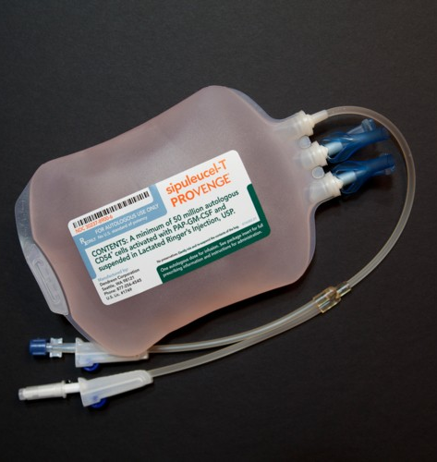
Provenge: first therapeutic cancer “vaccine”
Provenge is a type of immunotherapy that trains the patient’s own immune system to fight prostate cancer. The patient’s immune cells are trained to attack a protein that is highly expressed on prostate cancer cells.
Provenge gained EU marketing approval in 2013 for treatment-resistant, metastatic prostate cancer.
However, NICE concluded that the cost of the drug is too high for the limited benefit it may give to patients.
The manufacturer Dendreon discontinued Provenge for commercial reasons, but trials are now investigating earlier intervention and/or combination immunotherapy.
Notes:
In the UK around 400,000 men are living with and after prostate cancer.
Immunotherapy: the prevention or treatment of disease with substances that stimulate a immune response

Slide 68

Provenge: first therapeutic cancer “vaccine”
Clinical site
Manufacturing lab
Clinical site
1
Antigen presenting cells (APCs) are collected from the patient's blood via leukapheresis.
2
The APCs are exposed to a specially engineered protein designed to train the immune system to attack prostate cancer cells.
PAP–GM-CSF
4
The activated APCs are infused back into the patient’s blood where they travel to lymph nodes and activate PAP-specific T cells.
The PAP-specific T cells replicate and attack prostate cancer cells.
3
The patient’s APCs are now primed and mature. They are ready to instruct the patient’s T cells to attack cells that express PAP.
Notes:
This is a simplified overview of the process
APCs are a specialised type of white blood cell important for directing immune responses
The PAP-GM-CSF protein is composed of two parts:
PAP: found at high levels on prostate cancer cells
GM-CSF: stimulates APCs
T cells are another type of white blood cell that protect the body by attacking cells that are virally infected, foreign or cancerous

Slide 69
Provenge: first therapeutic cancer “vaccine”
“Whether used for prevention of infectious diseases or for prevention and treatment of cancer, vaccines work by similar mechanisms:
They teach the immune system how to recognize the infectious pathogen or the cancer cell as something foreign that needs to be eliminated"
Dr. Dmitriy Zamarin, Medical Oncologist,
Memorial Sloan Kettering Cancer Centre, New York
Back to example ATMPs

Slide 70
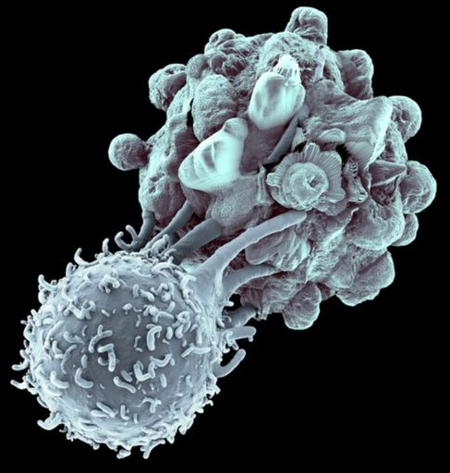
Tumour infiltrating lymphocytes (TILs)
Many cancers contain white blood cells known as tumour infiltrating lymphocytes (TILs).
TILs are implicated in killing tumour cells and are associated with favourable outcomes.
TILs can be extracted from the tumour, expanded and reinjected with promising clinical results.
Originally used in metastatic melanoma, TILs are in clinical trials in cervical, head & neck, breast, ovarian, pancreatic and non small cell lung carcinomas.
cancer cell
T cell
Coneyl Jay / Getty Images
Notes:
Image: A killer T cell lymphocyte (bottom) is attacking a cancer cell (top)
TIL therapy versus CAR-T Cell therapy
In CAR T cell therapy the patient’s T cells are genetically modified (hence it is a gene therapy medicinal product) and given back to kill tumour cells.
Unmodified TIL therapy expands existing T cells that can already recognise the cancer without genetic modification. They are classed as a somatic cell therapy medicinal product.
Despite promising results in haematological malignancies, CAR T cell therapy has not yet proved beneficial for solid tumours, whereas TILs have shown great promise in solid tumours.

Slide 71
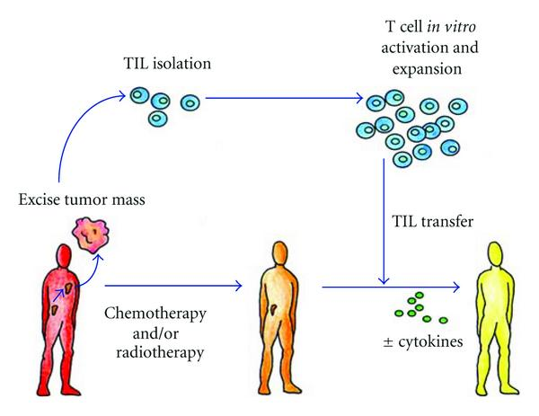
Tumour infiltrating lymphocytes (TILs)
A Amedei, E Niccolai & M D’Elios (2011) Clin Dev immunol
Notes:
Tumour infiltrating lymphocytes can be isolated from resected surgical samples and expanded in the lab. To help condition the body for the TIL transplant, patients receive a reversible lymphodepleting chemotherapy regimen before infusion. Usually cytokines such as IL-2 are infused following the TILs, in order to promote engraftment.
The cell expansion process typically takes ~4-6 weeks. 30-50 billion cells are required to make enough cells to return to the patient.

Slide 72
Tumour infiltrating lymphocytes (TILs)
“TIL [therapy] (as best we know now) requires products with 100 times [as many cells as CAR T therapy], on the order of 30–50 billion.
Cryopreserving that many cells and maintaining viability of the thawed product is certain to be a challenge.”
Dr Stephanie Goff
US National Cancer Institute (NCI)
Back to example ATMPs

Slide 73
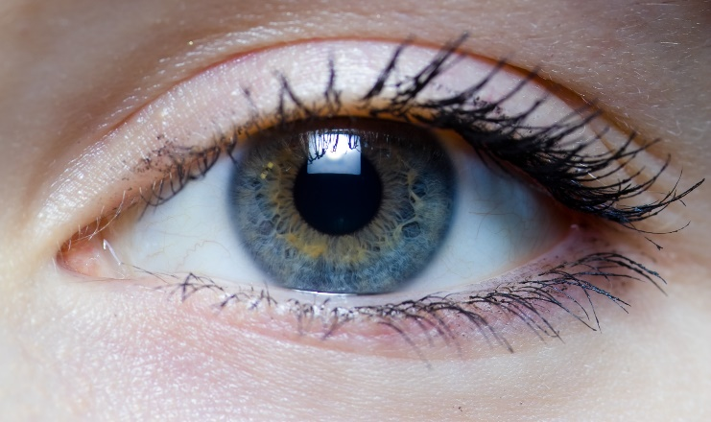
Holoclar: sight for sore eyes
Limbal stem cells, found in the limbus of the eye, damage to the outer layer of the cornea.
Injury to the eyes, such as physical or chemical burns, can damage limbal stem cells, causing the cornea to deteriorate.
Holoclar is a tissue engineered product that uses cells taken from a patient’s own limbus and then grown in a laboratory to repair the damaged corneal surface.
The limbus is the border between the sclera (white part of the eye) and the cornea (the clear front part of the eye)

Slide 74
Holoclar: sight for sore eyes
A tiny portion of undamaged limbus is biopsied from the eye
Cells are thawed
Limbal stem cells are grown in the lab (primary expansion)
Limbal stem cells are grown
onto a protein membrane
(secondary expansion)
Cells are harvested and cryopreserved
The new sheet of cornea is transplanted onto the injured eye
Adapted from Pellegrini et al. (2018) Stem Cells Transl
Notes:
Freezing an intermediate cell bank (ICB) has several advantages:
(a) it provides time for sufficient testing of the sample;
(b) it enables timing of the manufacture of the drug product to be aligned with patient, surgeon, and hospital facility availability;
(c) it can allow (dependent on the quantity available) a contingency sample of patient cells to be saved to be used in a second manufacturing round in case of failure of the first graft

Slide 75
Holoclar: sight for sore eyes
“Holoclar looks like a kind of contact lens. [It] provides a long-term transparent cornea and full recovery of visual acuity, without causing any rejection reaction, because it consists of cells of the patient him/herself.”
Professor Graziella Pellegrini,
Centre of Regenerative Medicine, Modena
Back to example ATMPs

Slide 76
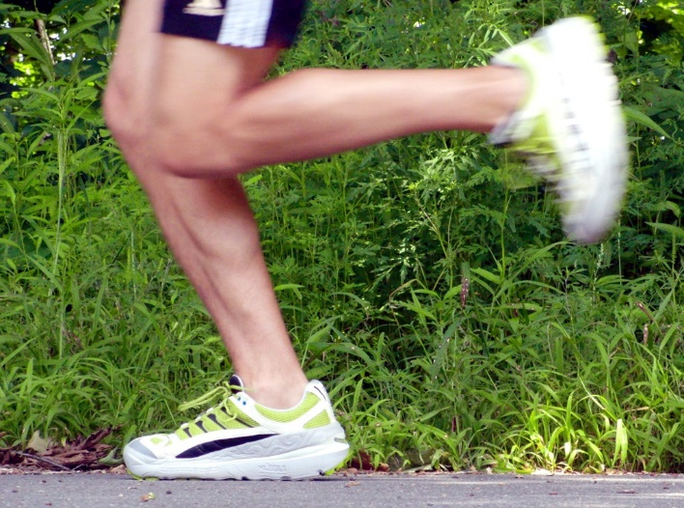
ACI: a grow your own knee replacement
Sports injury or trauma can cause defects or lesions in the smooth cartilage surface of the knee joint. Holes in the knee cartilage can result in painful rubbing and eventually lead to osteoarthritis.
Autologous chondrocyte implantation (ACI) uses cartilage cells (chondrocytes) taken from the patient’s own knee. The cells are grown outside the body for several weeks and then transplanted back into the knee underneath a periosteal patch.
The aim is to repair the damaged area by covering the defect with new cartilage. This can prevent patients living with severe pain and could mean that they avoid ever needing a prosthetic knee implant.
Notes:
Since a knee replacement typically wears out within 15 years, many younger patients may be ineligible for this surgery. Autologous chondrocyte implantation offers an alternative treatment for patients with minimal osteoarthritis damage to the knee.
Periosteal patch - A small patch made from the periosteum, a thick tissue that covers the surface of bones

Slide 77
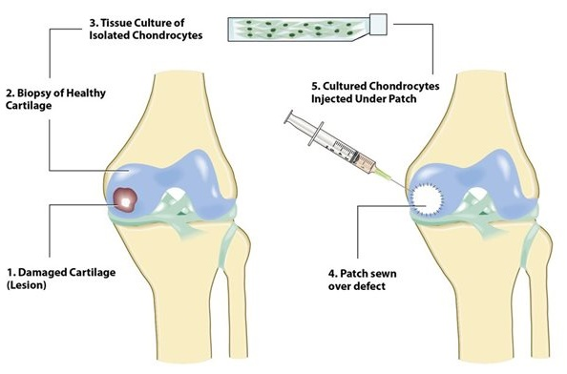
ACI: a grow your own knee replacement
Notes:
Periosteal patch - A small patch made from the periosteum, a thick tissue that covers the surface of bones

Slide 78
ACI: a grow your own knee replacement
“We can now regrow damaged joints using cells from the patient’s own body so there is no risk of rejection, sparing patients years of pain and without needing to use a plastic or metal implant.
We can rescue the knee and repair it so younger patients can stay active, return to sport and play with their children, and don’t face a knee replacement which eventually will need to be done again.”
Professor Leela Biant, Consultant Orthopaedic Surgeon,
Central Manchester University Hospitals and Spire Manchester Hospital.
Back to example ATMPs
Notes:
ChondroCelect was granted marketing authorisation in the EU on 5 October 2009 for repair of single symptomatic cartilaginous defects. The marketing authorisation was initially valid for a 5-year period. It was subsequently renewed for an additional 5-year period in 2014 but withdrawn in 2016 at the request of the marketing authorisation holder.

Slide 79
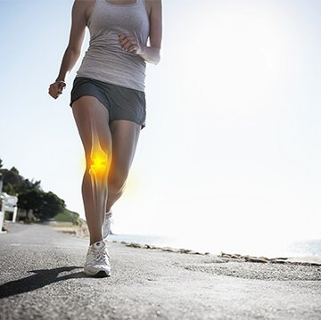
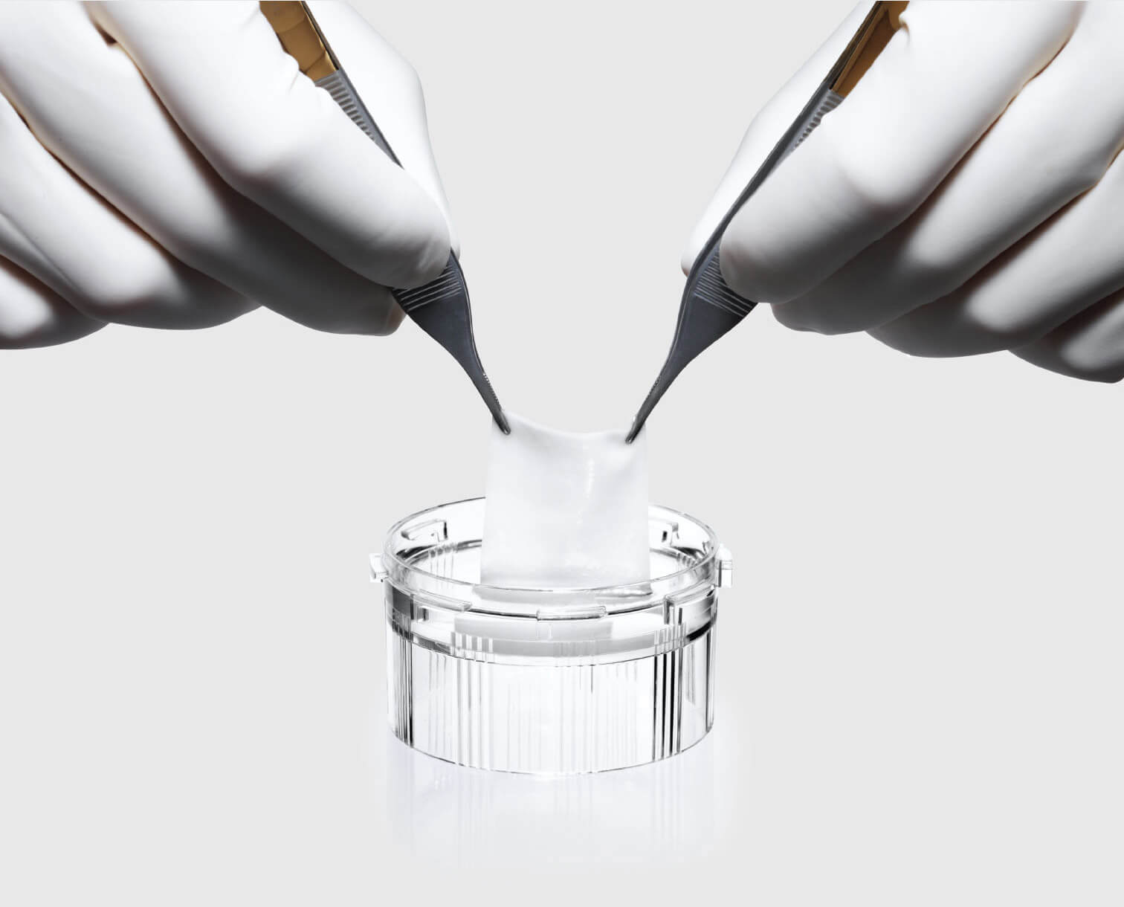
Example combined ATMP
MACI: Matrix-induced Autologous Chondrocyte Implantation for repairing cartilage defects
The patient’s chondrocytes are harvested and grown in the lab as in standard ACI.
The cultured cells are then seeded onto a collagen scaffold before being implanted onto the cartilage defect.
The implant can usually be held in place using a fibrin sealant.
MACI is currently unavailable in the EU due to the closure of the manufacturing site.
Back to example ATMPs
Photo credit: www.maci.com
Notes:
Since ACI was first developed in the late 1980s a variety of methods have been developed. ACI approaches that utilise a matrix and are also classified as a combined ATMP.
On 5 September 2014, the marketing authorisation holder for the advanced therapy medicine MACI (matrix applied characterised autologous cultured chondrocytes) closed the EU manufacturing site for the medicine, which is located in Denmark. Consequently, the licence of the manufacturing site was withdrawn. MACI is unavailable for new patients in the EU until a new manufacturing site has been registered in the EU. The closure was due to commercial reasons and the safety and effectiveness of MACI has not changed.

Slide 80
Directory of content
Background
Gene therapy
medicinal products
Somatic cell therapy medicinal products
Types of ATMP
with examples
Tissue engineered
products
Regulatory considerations
Combined ATMPs
Challenges
Supplementary material
including glossary and references
Notes:
Next we will move on to look at how ATMPs are regulated in the UK.

Slide 81




Regulatory framework for ATMPs in the EU
To ensure free movement of ATMPs within the EU
To facilitate access of these medicines to the EU market
To foster competitiveness of European pharmaceutical companies
To guarantee the highest level of health protection for patients
Regulation (EC) No 1394/2007 provides the overall regulatory framework for ATMPs.
Notes:
The regulatory framework for advanced therapy medicinal products (ATMPs) is designed to ensure the free movement of these medicines within the European Union (EU), to facilitate their access to the EU market, and to foster the competitiveness of European pharmaceutical companies in the field, while guaranteeing the highest level of health protection for patients.
Regulation (EC) No 1394/2007 provides the overall framework on ATMPs.

Slide 82



European regulatory bodies
European Commission (EC):
Propose and amend legislation
Grant legally binding EU Marketing Authorisation (MA)
European Medicines Agency (EMA):
Scientific evaluation, supervision and safety monitoring of medicines in the EU
Coordination of scientific evaluation for Marketing Authorisation (MA)
Developing guidelines in cooperation with expert committees & working groups
Notes:
In order for an ATMP to be placed on the market in the EU, manufacturers must apply for marketing authorisation (MA) via a centralised procedure conducted by the European Medicines Agency (EMA).
As with all medicines, the EMA continues to monitor safety and efficacy of ATMP after they are approved and marketed.

Slide 83


Human Tissue Authority (HTA)
In the UK, the HTA is the Competent Authority responsible for regulating human tissues and cells intended for human application.
HTA operate in line with Directive 2004/23/EC & associated EU Directives.
These are transposed in the UK as the Human Tissue (Quality and Safety for Human Application) Regulations 2007 (as amended).
Notes:
In the UK, the Human Tissue Authority (HTA) is the Competent Authority responsible for regulating human tissues and cells intended for human application.
They do this in line with Directive 2004/23/EC and associated EU Directives which have been transposed in the UK as the Human Tissue (Quality and Safety for Human Application) Regulations 2007 (as amended).

Slide 84
Medicines & Healthcare Products Regulatory Agency
(MHRA)
In the UK, the MHRA is the competent authority responsible for regulating human medicines, devices and blood and blood components for transfusion.
Medicinal products (including ATMPs) are regulated under Directive 2001/83/EC (amended by Regulation 1394/2007 on ATMPs)
This has been transposed in the UK as the Human Medicines Regulations 2012 (SI 2012/1916).
Notes:
In the UK, the Medicines and Healthcare products Reguatory Agency (MHRA) is the competent authority responsible for regulating human medicines, devices and blood and blood components for transfusion.
Medicinal products, including those classified as ATMPs, are regulated under Directive 2001/83/EC (amended by the ATMP Regulation No 1394/2007) on the Community code relating to medicinal products for human use which have been transposed in the UK as the Human Medicines Regulations 2012 (SI 2012/1916).

Slide 85




Committee for Advanced Therapies (CAT)
The EMA’s committee responsible for assessing the quality, safety and efficacy of ATMPs and following scientific developments in the field.
CAT prepares a draft opinion on each ATMP application submitted to the EMA, before the Committee for Medicinal Products for Human Use (CHMP) adopts a final opinion on the marketing authorisation of the medicine concerned.
CAT also provides scientific advice and issues scientific recommendation on ATMP classification.
Notes:
The Committee for Advanced Therapies (CAT) is the European Medicines Agency's (EMA) committee responsible for assessing the quality, safety and efficacy of advanced therapy medicinal products (ATMPs) and following scientific developments in the field.
It was established in accordance with Regulation (EC) No 1394/2007 on ATMPs as a multidisciplinary committee, gathering some of the best available experts in Europe.
Committee for Advanced Therapies assess quality, efficacy and safety of ATMPs, provide scientific advice and prepare draft opinion on whether marketing authorisation (MA) should be awarded.

Slide 86



Clinical trials
of ATMPs
The conduct of clinical trials on medicinal products for human use are regulated under Directives 2001/20/EC and 2005/28/EC.
These have been transposed in the UK as The Medicines for Human Use (Clinical Trials) Regulations 2004 (SI 2004/1013).
An Advanced Therapy Investigational Medicinal Product (ATIMP) is an ATMP which is tested or used in a clinical trial.
General principles of good clinical practice and good manufacturing practice apply to trials involving ATMPs. Additional guidelines are available on GMP and GCP specific to ATMPs.
Notes:
The conduct of clinical trials on medicinal products for human use are regulated under Directive 2001/20/EC and Directive 2005/28/EC which have been transposed in the UK as The Medicines for Human Use (Clinical Trials) Regulations 2004 (SI 2004/1013).
An Advanced Therapy Investigational Medicinal Product (ATIMP) is an ATMP which is tested or used in a clinical trial.
Good clinical practice must be followed as in any medicine.

Slide 87
Regulations for gene therapy
Investigational Medicinal Product (IMP) gene therapy medicinal products are regulated by the MHRA and Health and Safety Executive (HSE).
Licensed GTMPs are governed by the medicines regulators only.
If the therapeutic product has been genetically modified, the Genetically Modified Organisms (Contained Use) Regulations 2014 will apply.
Gene therapies are classified according to their potential to cause disease:
biosafety class 1 therapies do not cause human disease and are of negligible or low risk
biosafety class 2 therapies have a low risk of causing human disease.
Click for Pan-UK Pharmacy Working Group guidance on ’Requirements for Governance and Preparation of Gene Therapy’
Notes:
GTMPs used in clinical trials in the UK are regulated by the Health and Safety Executive (HSE) guidance on GMO and the Medicines and Healthcare products Regulatory Agency (MHRA), in addition to clinical trial and ethics regulations.
A local Genetic Modification Safety Committee (GMSC) must approve all gene therapy clinical trials.
HSE GMO guidance does not apply to licensed GTMPs following their market authorisation.
UK hospitals need to put governance procedures in place for the implementation of this new class of licensed products, as they are regulated by the European Medicines Agency and are not regulated by the HSE.

Slide 88
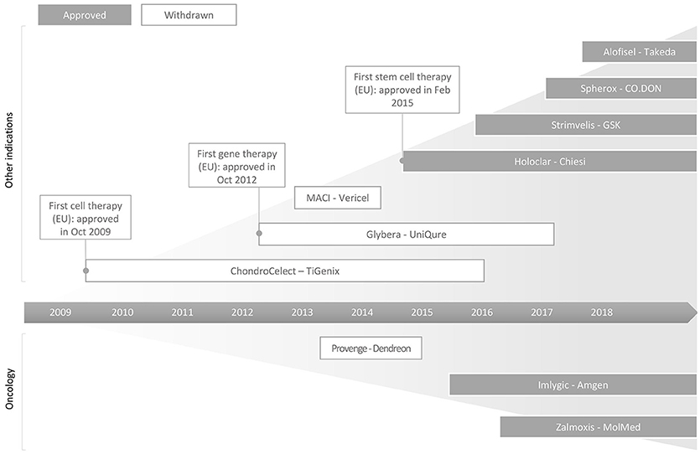
Successes and failures in the commercialisation of ATMPs in the EU
Yu et al. (2018) Front Bioeng Biotechnol
Notes:
Schematic illustration of successes and failures in the commercialisation of ATMPs in the EU.
NB: This figure is from March 2018 and does not show the licenced CAR T products. See next slide for a more up to date table.

Slide 89
Advanced therapy medicinal products granted marketing authorization in the EU
 | Product | Company | Description/indication | MA granted
Gene therapy | Yescarta® (Axicabtagene Ciloleucel) | Kite Pharma (Gilead) | CAR T cell therapy for adults with diffuse large B-cell lymphoma (DLBCL) or adults with primary mediastinal large B-cell lymphoma | 23 Aug 2018
 | Kymriah® (Tisagenlecleucel) | Novartis | CAR T cell therapy for children & young adults with B-cell acute lymphoblastic leukaemia (B-ALL) or adults with DLBCL | 23 Aug 2018
 | Spinraza® (Nusinersen) | Ionis Pharmaceuticals | Intrathecal injection of antisense oligonucleotide targeted to the SMN2 gene for patients with 5q spinal muscular atrophy (SMA) | 1 June 2017
 | Strimvelis® | Orchard Therapeutics | Ex vivo gene therapy for severe combined immunodeficiency due to adenosine deaminase deficiency (ADA-SCID) | 26 May 2016
 | Imlygic® (talimogene laherparepvec; T-VEC) | Amgen | Live, attenuated HSV-1 genetically modified to express huGM-CSF, for melanoma | 16 Dec 2015
 | Glybera® (alipogene tiparvovec) | UniQure | In vivo gene therapy for adults with lipoprotein lipase deficiency with severe/multiple attacks of pancreatitis | 25 Oct 2012 (ended Oct 2017)
Somatic cell therapy | Alofisel® (Darvadstrocel) | Takeda Pharma | Adipose-derived stem cells to treat complex perianal fistulas in Crohn’s disease | 23 March 2018
 | Zalmoxis® | MolMed | Adjunctive treatment in haploidentical haematopoietic stem cell transplantation (HSCT) of adult patients with high-risk haematological malignancies | 18 August 2016
 | Provenge® (Sipuleucel-T) | Dendreon | Immunotherapy “vaccine” for prostate cancer | 6 Sept 2013 (withdrawn May 2015)
Tissue engineered | Chondrosphere®(Spherox) | CO.DON | Spheroids of autologous matrix-associated chondrocytes to repair knee cartilage | 10 July 2017
 | Holoclar® | Chiesi | Stem cell treatment to replace damaged cells in the cornea | 17 Feb 2015
 | ChondroCelect® | TiGenix | Autologous chondrocyte implant to repair cartilage defects in the knee | 5 Oct 2009 (withdrawn July 2016)
cATMP | MACI® | Vericel | Matrix-induced autologous chondrocyte implant to repair cartilage defects in the knee | 27 June 2013 (suspended Sept 2014)
Notes:
MA - Market Authorisation
w/d – withdrawn
Susp - suspended

Slide 90
Directory of content
Background
Gene therapy
medicinal products
Somatic cell therapy medicinal products
Types of ATMP
with examples
Tissue engineered
products
Regulatory considerations
Combined ATMPs
Challenges
Supplementary material
including glossary and references
Notes:
This is to provide an outline of how the slide deck is structured.

Slide 91
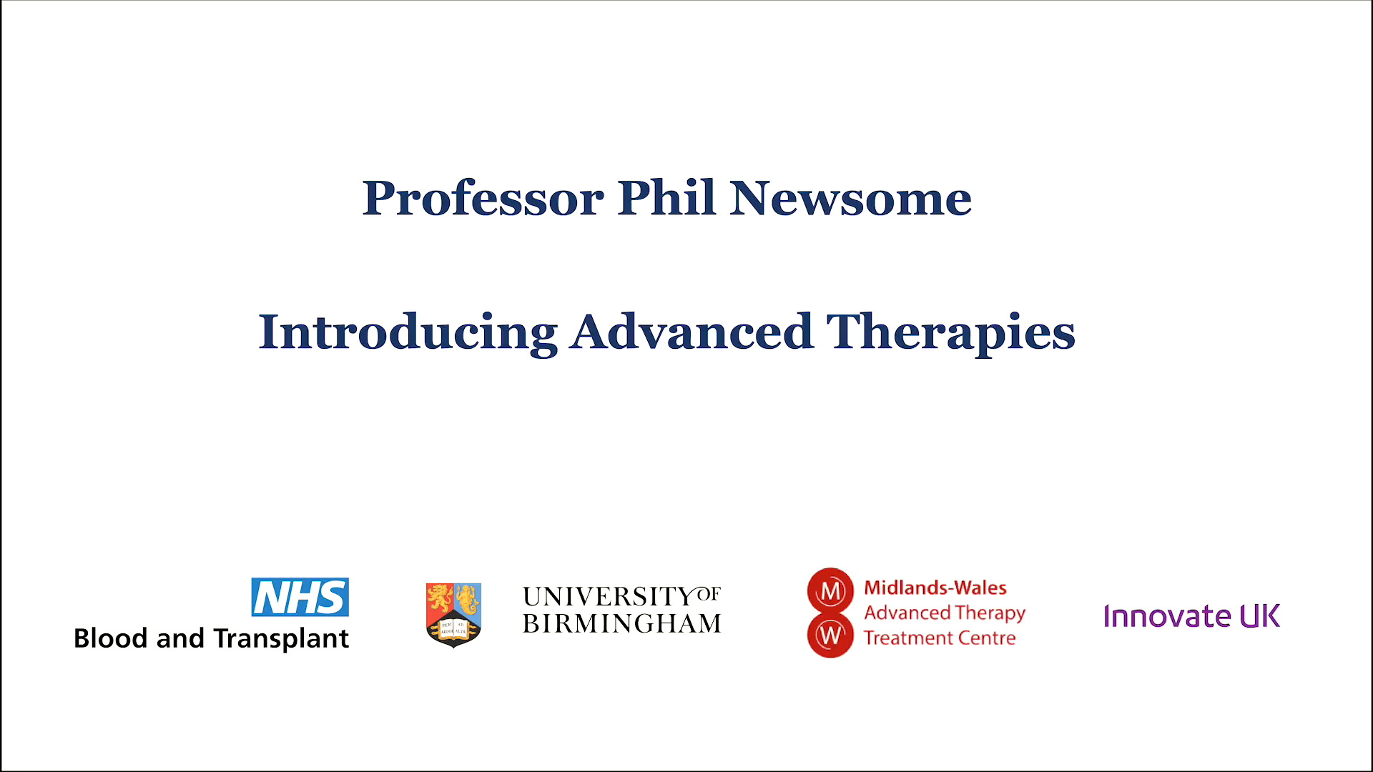

Slide 92

Clinical challenges 1
Safety issues associated with some therapies
Efficacy yet to be established for some therapies
Patient recruitment may be difficult
Follow up – patient may need to remain close to treatment centre for extended period
Managing expectations
Hesitance towards handling/receiving gene therapies
Notes:
Safety issues associated with some therapies
Known side effect profile of CAR T cells - future generations of CAR T cells may be engineered to incorporate a ‘suicide switch’, so that if the patient suffers an adverse reaction the CAR T’s can be deactivated.
Side effects of novel therapies may be unknown, particularly in the longer term
Insertional mutagenesis:
Virus-based vectors integrate permanently into genomic DNA, thus driving long-term expression of corrective genes. But if the new genes get inserted in the wrong place in the DNA, there is a chance that the insertion might interrupt a tumour suppressor gene or activate an oncogene and lead to the development of malignant disorders.
Another big challenge around CAR T is with treating solid tumours. It is difficult find antigens that are uniquely expressed by cancer cells and not present at all on healthy cells. One strategy that’s being explored is to produce T cells expressing two different CARs, so that the CAR T cell will only kill cells that express two specific antigens.
Patient recruitment - often rare indications.

Slide 93
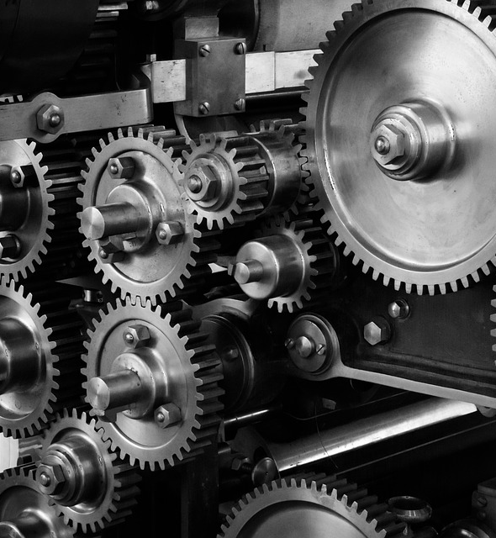
Clinical challenges 2
Effective communication across multiple clinical
areas, manufacturer, courier, tracking service…
Living products: storage/handling requirements
Novel methods of administration
Increasing numbers of patients and products
Novel hospital infrastructure, governance, clinical pathways
Training and retaining staff
Notes:
Manufacture can be long and complex involving many steps at which things could go wrong so critical need for effective communication between all parties.
Transportation (of starting material and final product) may be international. Pay attention to handovers!
Administration may include use of specialised devices
Increasing numbers of patients and different products
Staff education and training:
Need enough trained staff to cope with sickness, leave etc.
Use carefully controlled procedures, identify ways to assess competency
Keep up to date, communicate any changes
Perceptions of gene therapies – education is key

Slide 94
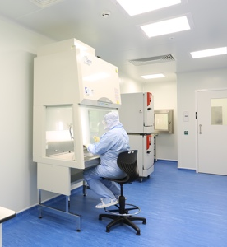
Manufacturing challenges
Complex, multi-step, manual processes; how to scale up
Variation in quality of starting material
High volumes of product required for quality testing
Few suppliers providing appropriately certified starting materials
Short shelf life of product requires new solutions for shipping, preservation & QC
Training and retaining staff
Notes:
QC – quality control

Slide 95

Regulatory and financial challenges
Differing country-specific requirements
International transportation of human tissue
Difficulty meeting regulators’ information requests
Funding product development
Uncertainty around reimbursement

Slide 96




The bigger picture
Potential new UK jobs in advanced therapy by 2030
180,000
Targeted, often one-off treatments that may remove the need for long-term medical care
Estimated value of UK cell and gene therapy market by 2035
£10bn
Potential to improve or save patients’ lives where current treatments may be inadequate
Notes:
Estimates suggest that the UK cell and gene therapy market may reach 10 billion pounds by 2035.
Huge potential for economic growth and the creation of thousands of jobs in the UK.
Targeted, one-off treatments that may remove the need for long-term medical care
Potential to improve or save patients’ lives where current treatments may be inadequate

Slide 97
Check your learning
Having completed this module you should:
  Understand some of the technical terms used to describe advanced therapy medicinal products (ATMPs)
  Be familiar with some examples of different types of advanced therapies
  Be aware of how these therapies are regulated in the UK
  Be able to describe some key challenges around delivery of advanced therapies

Slide 98




Acknowledgements
Produced by Dr Ceri Roberts, NHS Blood and Transplant
for the Midlands-Wales Advanced Therapy Treatment Centre
funded by Innovate UK as part of UK Research and Innovation’s Industrial Strategy.
With grateful thanks to reviewers:
Dr Eric Austin, NHS Blood and Transplant
Joanne Bagshawe, Welsh Blood Service
Debbie Beirne, Leeds Teaching Hospitals NHS Trust
Dr Sue Davey, NHS Blood and Transplant
Michelle Davies, The Christie NHS Foundation Trust
Ian Hollingsworth, Cell and Gene Therapy Catapult
Michelle Kenyon, King’s College Hospital NHS Foundation Trust
Shona McDermott, NHS Greater Glasgow & Clyde
Kathryn Rodden, University Hospitals Birmingham NHS Foundation Trust
Jacqui Thompson, NHS Blood and Transplant
Dr Glenda Watson, Imperial College London

Slide 99
Supplementary material

Slide 100
Glossary of terms (1 of 4)
Term | Definition
Allogeneic | Where donor and recipient are different individuals
Advanced Therapy Medicinal Product (ATMP) | a medicinal product which is either: a gene therapy medicinal product a somatic cell therapy medicinal product a tissue engineered product defined in Directive 2001/83/EC as amended by the ATMP Regulation 1394/2007 and includes combination ATMPs.
ATIMP | An ATMP which is an IMP
Autologous | Where donor and recipient are the same individual
Committee on Advanced Therapies (CAT) | Committee within the EMA set up to assess quality, safety and efficacy of ATMPs

Slide 101
Glossary of terms (2 of 4)
Term | Definition
European Medicines Agency (EMA) | Decentralised agency of the European Union (EU) responsible for the scientific evaluation, supervision and safety monitoring of medicines in the EU
Ex vivo | Outside of the living body
Genetically Modified Organism (GMO) | An organism, with the exception of human beings, in which the genetic material has been altered in a way that does not occur naturally by mating and/or natural recombination.
Good Manufacturing Practice (GMP) | Part of quality assurance which ensures that medicinal products are consistently produced and controlled to appropriate quality standards
Human Tissue Authority (HTA) | The UK's Competent Authority under the Quality and Safety Regulations that licenses the procurement, testing, processing, storage, distribution and import/export of tissues and cells for human application.

Slide 102
Glossary of terms (3 of 4)
Term | Definition
Investigational medicinal product (IMP) | A pharmaceutical form of an active substance or placebo being tested or used as a reference in a clinical trial, including products already with a marketing authorization but used or assembled (formulated or packaged) in a way different from the authorised form/for an unauthorised indication/to gain further information about the authorised form
In vivo | Inside of the living body
Induced pluripotent stem (iPS) cell (or iPSC) | Differentiated cells that have been reprogrammed to a pluripotent stem cell state
Marketing Authorisation (MA) | Medicines, which meet the standards of safety, quality and efficacy, are granted a marketing authorisation (previously a 'product licence'), which is normally necessary before they can be prescribed or sold.

Slide 103
Glossary of terms (4 of 4)
Term | Definition
Medicines and Healthcare products Regulatory Agency (MHRA) | Responsible for regulating all medicines and medical devices in the UK by ensuring they work and are acceptably safe
Mesenchymal stromal/stem cell (MSC) | Multipotent stromal cells that can differentiate into various cell types, including osteoblasts (bone cells), chondrocytes (cartilage cells), myocytes (muscle cells) and adipocytes (fat cells)
Multipotent | Can give rise to specialised cell types in a particular tissue or organ
Pluripotent | Can give rise to all cell types of the body
Somatic cell | Any cell of a living organism other than the reproductive (sperm and egg) cells
Stem cell | A general term to describe an unspecialised cell. For example, haematopoietic stem cells reside in the bone marrow and give rise to cells of the blood system. Other types of stem cell are can be found in different parts of the body and have different functions.

Slide 104
Selected ATMPs in the process of marketing authorisation, or with a planned marketing launch
Product | Developer | Indication | Regulatory status | Clinical trial information | Participants | Estimated completion
LuxturnaTM | Novartis | Biallelic RPE65-mediated retinal dystrophy | MAA submitted EMA: CHMP pos. opinion 09/2018 | Phase III - NCT00999609 | 24 | 2029
LentiGlobinTM | BlueBird Bio | Transfusion dependant ß-thalassemia, sickle cell disease | MAA submitted EMA: accelerated approval granted | Phase III - NCT02906202 | 23 | 2020
HabeoTM | Cytori Therapeutics | Hand dysfunction due to scleroderma | EMA: Orphan drug designation granted | Phase n.a. - NCT02396238 | 88 | 2018
Lenti-DTM | BlueBird Bio | Cerebral adrenoleukodystrophy |  | Phase II/III - NCT01896102 | 30 | 2021
Neocart® | Histogenics corporation | Cartilage repair |  | Phase III - NCT01066702 | 245 | 2020
JCAR 017 | Celgene | DLBCL | EMA: PRIME | Phase III - NCT03575351 | 182 | 2023
bb2121 | Celgene | Multiple myeloma | EMA: PRIME eligibility 11/2017 | Phase III - NCT03651128 | 381 | 2025
Tab-celTM | Atara Biotherapeutics | EBV associated post-transplant lymphoproliferative disorder |  | Phase III - NCT03392142 | 33 | 2020
Lenadogene nolparvovec | GenSight Biologics SA | Vision loss from Leber hereditary optic neuropathy |  | Phase III - NCT02652767 | 36 | 2019
REX-001 | Rexgenero | Critical limb ischemia | EMA: Certificate for manufacturing and non-clinical data 01/2018 | Phase III - NCT03174522 | 78 | 2021
Multistem | Athersys | Ischemic stroke |  | Phase III - NCT03545607 | 300 | 2021
PLX-PAD | Pluristem therapeutics | Critical limb ischemia |  | Phase III - NCT03006770 | 246 | 2020
Adapted from Eder & Wild https://doi.org/10.1080/20016689.2019.1600939
Notes:
Table adapted from Technology forecast: advanced therapies in late clinical research, EMA approval or clinical application via hospital exemption
Claudia Eder & Claudia Wild
https://doi.org/10.1080/20016689.2019.1600939
Table 4: ATMPs in the process of marketing authorisation or with a planned marketing launch.

Slide 105
References and further reading (1 of 4)
Resource | Link
Regulation (EC) No 1394/2007 | https://ec.europa.eu/health//sites/health/files/files/eudralex/vol-1/reg_2007_1394/reg_2007_1394_en.pdf
Directive 2001/83/EC | https://ec.europa.eu/health//sites/health/files/files/eudralex/vol-1/dir_2001_83_consol_2012/dir_2001_83_cons_2012_en.pdf
Directive 2001/18/EC | https://eur-lex.europa.eu/legal-content/EN/TXT/HTML/?uri=CELEX:32001L0018&from=EN
Central dogma (molecular biology) | https://www.yourgenome.org/facts/what-is-the-central-dogma
Number of cells in the body | https://doi.org/10.1371/journal.pbio.1002533
2013 House of Lords report on Regenerative Medicine | https://publications.parliament.uk/pa/ld201314/ldselect/ldsctech/23/23.pdf
What is a stem cell | https://www.yourgenome.org/facts/what-is-a-stem-cell

Slide 106
References and further reading (2 of 4)
Resource | Link
The Role of Pharmacy in Successful Delivery of ATMPs | https://www.theattcnetwork.co.uk/wp-content/uploads/2019/06/The-Role-of-Pharmacy-in-the-Successful-Delivery-of-Advanced-Therapy-Medicinal-Products-ATMPs-1.pdf
Cancer Research UK: Science blog on CAR T cells | https://scienceblog.cancerresearchuk.org/2018/10/05/cutting-edge-car-t-cell-immunotherapy-approved-in-england-but-is-the-nhs-ready/
NIH National Cancer Institute: CAR T cells | https://www.cancer.gov/about-cancer/treatment/research/car-t-cells
NICE guidance Feb 2018: Strimvelis for ADA-SCID | https://www.nice.org.uk/guidance/hst7
EMA summary for the public: Strimvelis for ADA-SCID | https://www.ema.europa.eu/documents/overview/strimvelis-epar-summary-public_en.pdf
BBC: Teenager's sickle cell reversed with world-first therapy | https://www.bbc.co.uk/news/health-39142971

Slide 107
References and further reading (3 of 4)
Resource | Link
New England Journal of Medicine: Gene Therapy in a Patient with Sickle Cell Disease | https://www.nejm.org/doi/full/10.1056/nejmoa1609677
BBC: 'Butterfly child' given life-saving skin | https://www.bbc.co.uk/news/health-41914101
Nature: Regeneration of the entire human epidermis using transgenic stem cells | https://www.nature.com/articles/nature24487
EMA summary for the public: Glybera for LPL deficiency | https://www.ema.europa.eu/documents/overview/glybera-epar-summary-public_en.pdf
EMA public statement on Glybera MA expiry | https://www.ema.europa.eu/documents/public-statement/public-statement-glybera-expiry-marketing-authorisation-european-union_en.pdf
EMA public assessment report: Alofisel | https://www.ema.europa.eu/en/medicines/human/EPAR/alofisel

Slide 108
References and further reading (4 of 4)
Resource | Link
NICE recommendation on Alofisel | https://www.nice.org.uk/guidance/ta556
EMA public assessment report: Provenge | https://www.ema.europa.eu/en/medicines/human/EPAR/provenge
EMA public assessment report: Holoclar | https://www.ema.europa.eu/en/medicines/human/EPAR/holoclar
EMA public assessment report: ChondroCelect | https://www.ema.europa.eu/en/medicines/human/EPAR/chondrocelect
EMA public statement on withdrawal of MA for Chondrocelect | https://www.ema.europa.eu/documents/public-statement/public-statement-chondrocelect-withdrawal-marketing-authorisation-european-union_en.pdf
Closure of MACI manufacturing site | https://www.ema.europa.eu/en/medicines/human/referrals/maci
EC Guidelines on Good Clinical Practice specific to ATMPs | https://ec.europa.eu/health/sites/health/files/files/eudralex/vol-10/atmp_guidelines_en.pdf

Slide 109
Image and video sources (1 of 3)
Resource | Link
Cell-fie cartoon | http://www.christineluong.tumblr.com
Cell and DNA cartoon | http://www.cancermoonshotlund.com/index.php/6-what-are-genes-dna-and-proteins/
Video of dividing mesenchymal stem cells | https://vimeo.com/336568078
Stem cell/types of stem cell cartoons | https://www.yourgenome.org/facts/what-is-a-stem-cell
iPSC cartoon | https://www.sanger.ac.uk/news/view/scientists-unveil-uk-s-largest-resource-human-stem-cells-healthy-donors
Schematic of haematopoietic stem cell transplantation | https://www.mssociety.org.uk/about-ms/treatments-and-therapies/disease-modifying-therapies/hsct
First child treated with CAR T | https://directorsblog.nih.gov/2017/08/30/fda-approves-first-car-t-cell-therapy-for-pediatric-acute-lymphoblastic-leukemia/

Slide 110
Image and video sources (2 of 3)
Resource | Link
CAR T cell production process | https://www.cancer.gov/publications/dictionaries/cancer-terms/def/car-t-cell-therapy
CAR T cell soldier cartoon | https://www.facebook.com/pedromics/photos/a.110862089106492/590311554494874/?type=3&theater
‘Boy in the bubble’ photo | https://blog.cirm.ca.gov/2017/03/29/bye-bye-bubble-baby-disease-promising-results-from-stem-cell-gene-therapy-trial-for-scid/
Epidermolysis bullosa patient and gene therapy schematic | https://www.bbc.co.uk/news/health-41914101
Lipaemic plasma from LPL patient | https://www.cmaj.ca/content/176/8/1113/F1
Injection of MSCs into perianal fistulas | https://www.nature.com/articles/nrgastro.2017.104

Slide 111
Image and video sources (3 of 3)
Resource | Link
Provenge product bag | https://www.clinicaltrialsarena.com/projects/provenge-for-the-treatment-of-advanced-prostate-cancer/
Killer T cell attacking a cancer cell | https://www.thoughtco.com/t-cells-meaning-373354
Schematic of tumour infiltrating lymphocyte production | https://www.researchgate.net/figure/Scheme-of-adoptive-autologous-TILs-transfer-T-infiltrating-lymphocytes-can-be-isolated_fig2_51824063
BBC video of EB gene therapy patient | https://www.bbc.co.uk/news/health-41914101
Autologous chondrocyte implantation schematic | https://www.rjah.nhs.uk/Our-Services/Orthopaedic-Surgery/Cartilage-Cell-Transplantation.aspx
Schematic of successes and failures in the commercialisation of ATMPs in the EU | doi.org/10.3389/fbioe.2018.00130

